Slide 1
Chapter 10: INFINITE SERIES
Contents:
10.1 Sequences
10.2 Summing an Infinite Series
10.3 Convergence of Series with Positive Terms
10.4 Absolute and Conditional Convergence
10.5 The Ratio and Root Tests and Strategies for Choosing Tests
10.6 Power Series
10.7 Taylor Polynomials
10.8 Taylor Series

Slide 2
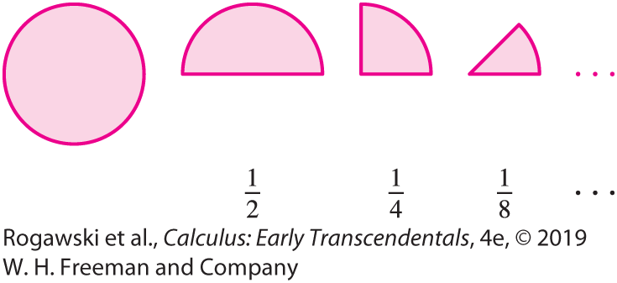

10.1 Sequences (1 of 29)
Limits and convergence played a fundamental role in the definitions of the derivative and definite integral. The limit concept will be significant throughout this chapter. We start by developing the basic ideas of a sequence of numbers and the limit of such a sequence.
A simple sequence of numbers arises if you eat half of a cake, and eat half of the remaining half, and continue eating half of what’s left indefinitely (Figure 1). The fraction of the whole cake that remains after each step forms the sequence
$$\frac{1}{2}, \frac{1}{4}, \frac{1}{8}, ⋯$$
This is the sequence of values of the function
f (n) = $\frac{1}{2^{n}}$ for n = 1, 2, ... .

Slide 3

10.1 Sequences (2 of 29)
DEFINITION: Sequence A sequence {a_{n} } is an ordered collection of numbers defined by a function f on a set of sequential integers. The values a_{n} = f (n) are called the terms of the sequence, and n is called the index. Informally, we think of a sequence {a_{n} } as a list of terms:
a₁, a₂, a₃, a₄, ...
The sequence does not have to start at n = 1. It can start at n = 0, n = 2, or any other integer.
When a_{n} is given by a formula, we refer to a_{n} as the general term, and we refer to the set of the values n on which the sequence is defined as the domain of the sequence. For example, in the cake sequence, a_{n} = $\frac{1}{2^{n}}$ is the general term and the domain is n ≥ 0.

Slide 4
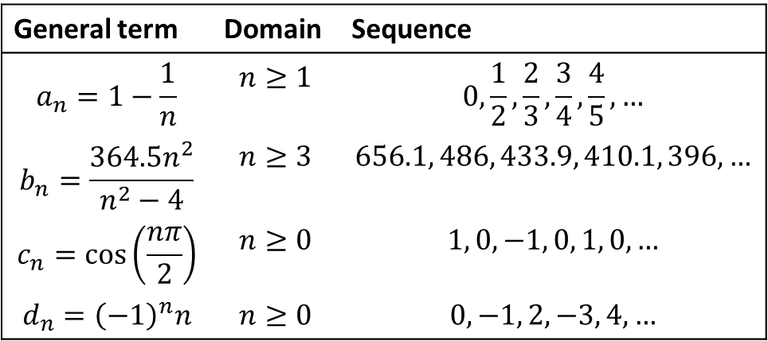
10.1 Sequences (3 of 29)
Not all sequences are generated by a formula. For instance, the sequence of digits in the decimal expansion of π is
3, 1, 4, 1, 5, 9, 2, 6, ...
There is no specific formula for the nth digit of π, and therefore there is no formula for the general term in this sequence.
General term | Domain | Sequence
$$a_{n}=1−\frac{1}{n}$$ | $$n≥1$$ | $$0, \frac{1}{2}, \frac{2}{3}, \frac{3}{4}, \frac{4}{5}, …$$
$$b_{n}=\frac{364.5n^{2}}{n^{2}−4}$$ | $$n≥3$$ | $$656.1, 486, 433.9, 410.1, 396,…$$
$$c_{n}=\cos\left(\frac{nπ}{2}\right)$$ | $$n≥0$$ | $$1, 0, −1, 0, 1, 0, …$$
$$d_{n}={\left(−1\right)}^{n}n$$ | $$n≥0$$ | $$0, −1, 2, −3, 4, …$$

Slide 5
10.1 Sequences (4 of 29)
The sequence in the next example is defined recursively. For such a sequence, the first one or more terms may be given, and then the nth term is computed in terms of the preceding terms using some formula.
EXAMPLE: The Fibonacci Sequence We define the sequence by taking F₁ = 1, F₂ = 1, and F_{n} = F_{n−1} + F_{n−2} for all integers n > 2. In other words, each subsequent term is obtained by adding together the two preceding terms. Determine the first 10 terms in the sequence.
Solution Given the first two terms, we can easily find each subsequent term by adding the previous two. The sequence is
1, 1, 2, 3, 5, 8, 13, 21, 34, 55 ...

Slide 6
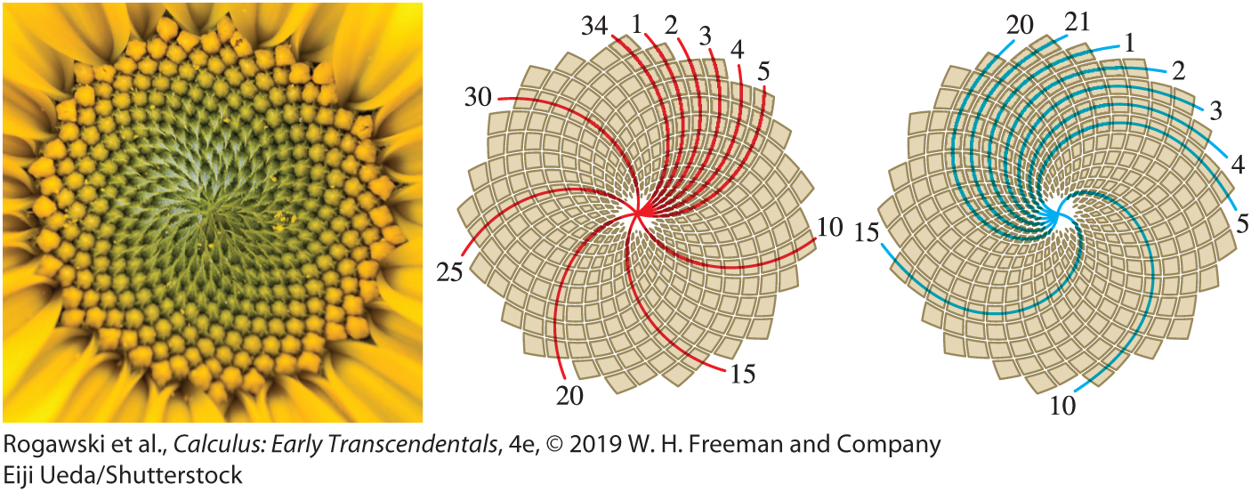
10.1 Sequences (5 of 29)
The Fibonacci sequence appears in a surprisingly wide variety of situations, particularly in nature. For instance, the number of spiral arms in a sunflower almost always turns out to be a number from the Fibonacci sequence, as in Figure 2.

Slide 7

10.1 Sequences (6 of 29)
EXAMPLE: Compute a₂, a₃, a₄ for the sequence defined recursively by
$$a_{1}=1, a_{n}=\frac{1}{2}\left(a_{n−1}+\frac{2}{a_{n−1}}\right)$$
Solution
$$a_{2}=\frac{1}{2}\left(1+\frac{2}{1}\right)=\frac{3}{2}≈1.5$$
$$a_{3}=\frac{1}{2}\left(\frac{3}{2}+\frac{2}{3/2}\right)=\frac{17}{12}≈1.4167$$
$$a_{4}=\frac{1}{2}\left(\frac{17}{12}+\frac{2}{{17}/{12}}\right)=\frac{577}{408}≈1.414216$$

Slide 8

10.1 Sequences (7 of 29)
Our main goal is to study convergence of sequences. A sequence {a_{n} } converges to a limit L if |a_{n} − L| becomes arbitrarily small when n is sufficiently large. Here is the formal definition.
DEFINITION: Limit of a Sequence We say that {a_{n} } converges to a limit L, and we write
$$\lim_{n→∞}{a_{n}}=L or a_{n}→∞ (n→∞)$$
if, for every E > 0, there is a number M such that |a_{n} − L| <E for all n > M.
If no limit exists, we say that {a_{n} } diverges.
If the terms increase without bound, we say that {a_{n} } diverges to infinity.

Slide 9
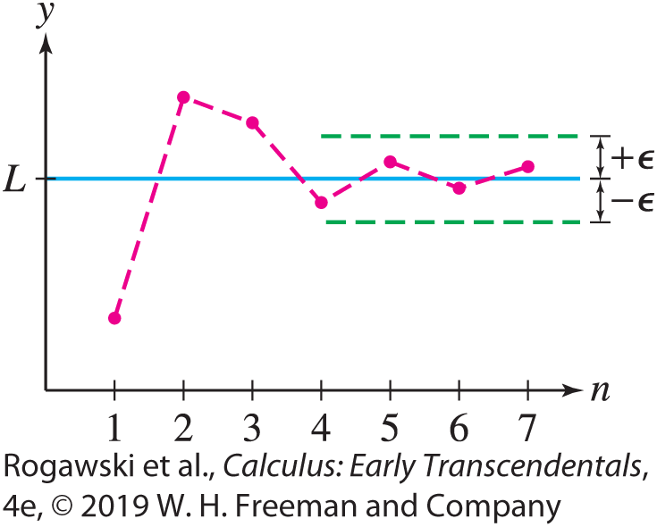

10.1 Sequences (8 of 29)
If {a_{n} } converges, then its limit L is unique. A good way to visualize the limit is to plot the points (1, a₁), (2, a₂), (3, a₃), ... , as in Figure 3. The sequence converges to L if, for every $∈$ > 0, the plotted points eventually remain within an $∈$-band around the horizontal line y = L.

Slide 10
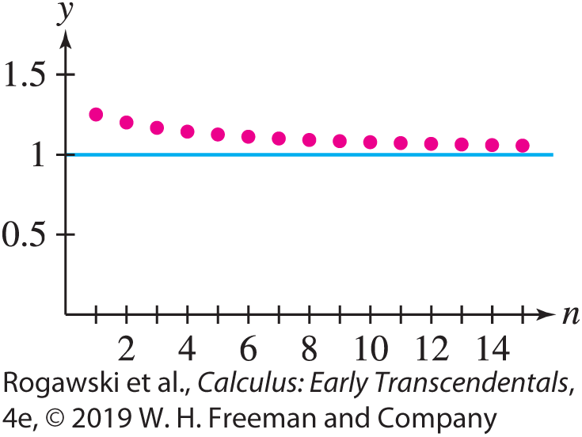
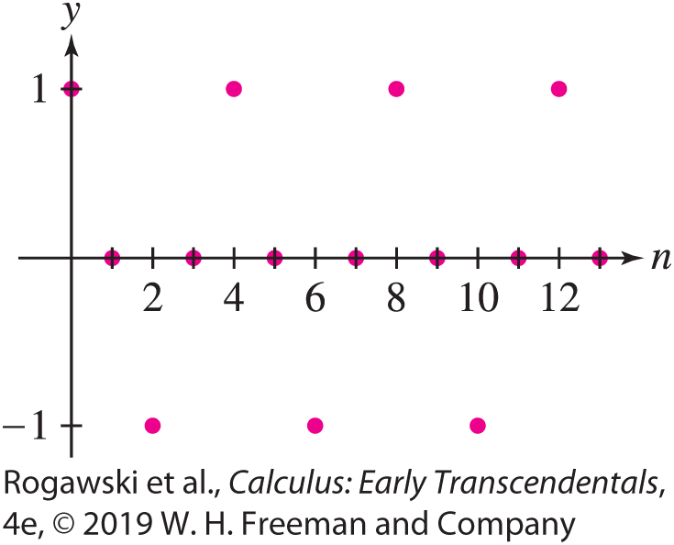

10.1 Sequences (9 of 29)
Figure 4 shows the plot of a sequence converging to L = 1.
On the other hand, since it continually cycles through 1, 0, −1, 0, the sequence $c_{n}=\cos\left(\frac{nπ}{2}\right)$ in Figure 5 has no limit.

Slide 11

10.1 Sequences (10 of 29)
EX AMPLE: Proving Convergence Let a_{n} = $\frac{n + 4}{n + 1}$ . Prove that $\lim_{n→∞}{a_{n}=1.}$
Solution The definition requires us to find, for every E > 0, a number M such that
| a_{n} − 1| <E for all n > M. We have
$$\left|a_{n}−1\right|=\frac{n+4}{n+1}−1=\frac{3}{n+1}$$
Therefore, | a_{n} − 1| <E if
$$\frac{3}{n+1}<E or n>\frac{3}{E}−1$$
In other words, | a_{n} − 1| <E for all $n>\frac{3}{E}−1$. This proves $\lim_{n→∞}{a_{n}=1.}$

Slide 12

10.1 Sequences (11 of 29)
Note the following two facts about sequences:
The limit does not change if we change or drop finitely many terms of the sequence.
If C is a constant and a_{n} = C for all n greater than some fixed value N, then $\lim_{n→∞}{a_{n}=C.}$
Many of the sequences we consider are defined by functions; that is, a_{n} = f (n) for some function f . For example,
$$a_{n}=\frac{n−1}{n} is defined by f\left(x\right)=\frac{x−1}{x}$$

Slide 13
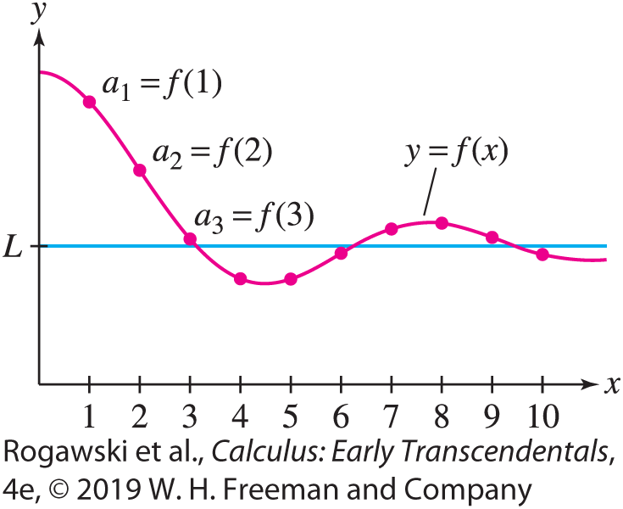

10.1 Sequences (12 of 29)
We will often use the fact that if f (x) approaches a limit L as x → ∞, then the sequence a_{n} = f (n) approaches the same limit L (Figure 6). Indeed, if for all E > 0 we can find a positive real number M so that | f (x ) − L| <E for all x > M, then it follows automatically that | f (n) − L| <E for all integers n > M.
THEOREM: Sequence Defined by a Function
If $\lim_{x→∞}{f\left(x\right)}$ exists, then the sequence a_{n} = f (n)
converges to the same limit:
$$\lim_{n→∞}{a_{n}}=\lim_{x→∞}{f\left(x\right)}$$

Slide 14

10.1 Sequences (13 of 29)
EXAMPLE: a) To find the limit of the sequence
$\frac{2^{2}− 2}{2^{2}}$,$\frac{3^{2}− 2}{3^{2}}$, $\frac{4^{2}− 2}{4^{2}}$, $\frac{5^{2}− 2}{5^{2}}$,…,
we observe that its general term is $a_{n}=\frac{n^{2}− 2}{n^{2}}=1−\frac{2}{n^{2}}.$ We apply the last theorem with $f\left(x\right)=1−\frac{2}{x^{2}}$:
$$\lim_{n→∞}{a_{n}}=\lim_{x→∞}\left(1−\frac{2}{x^{2}}\right)=1−\lim_{x→∞}{\frac{2}{x^{2}}}=1−0=1$$
b) To calculate $\lim_{n→∞}{\frac{n + \ln{n}}{n^{2}}}$, we use L’Hôpital’s Rule:
$$\lim_{n→∞}{\frac{n+\ln{n}}{n^{2}}}=\lim_{x→∞}{\frac{x+\ln{x}}{x^{2}}}=\lim_{x→∞}{\frac{1+(1/x)}{2x}}=0$$

Slide 15
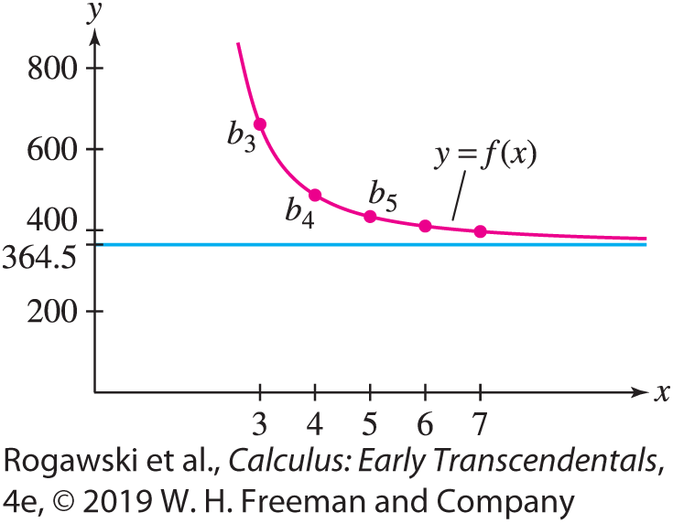
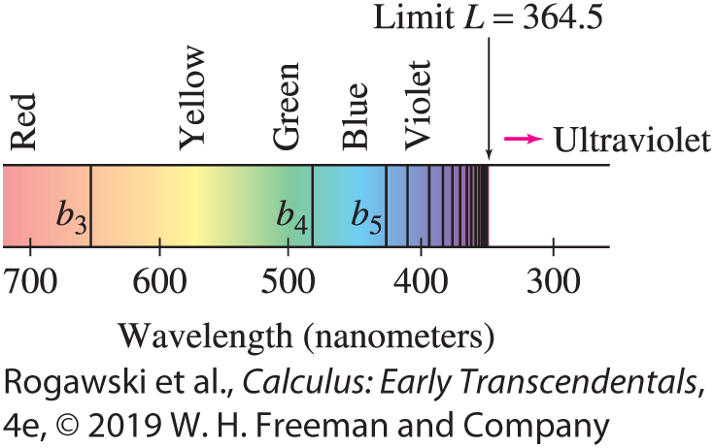
10.1 Sequences (14 of 29)
The limit of the Balmer wavelengths b_{n} in the next example plays a role in physics and chemistry because it determines the ionization energy of the hydrogen atom. Figure 7 plots the sequence and the graph of a function f that defines the sequence. In Figure 8, the wavelengths are shown “crowding in” toward their limiting value.

Slide 16

10.1 Sequences (15 of 29)
EXAMPLE: Balmer Wavelengths
Calculate the limit of the Balmer wavelengths $b_{n}=\frac{364.5n^{2}}{n^{2}− 4}$in nanometers, where n ≥ 3.
We apply the last theorem with $f\left(x\right)=\frac{364.5x^{2}}{x^{2}− 4}$:
$$\lim_{n→∞}{b_{n}}=\lim_{x→∞}{\frac{364.5x^{2}}{x^{2}−4}}=\lim_{x→∞}{\frac{364.5x^{2}}{x^{2}(1−\left(4/{x^{2}}\right))}}=\lim_{x→∞}{\frac{364.5}{ (1−\left(4/{x^{2}}\right))}}=364.5 nm$$

Slide 17
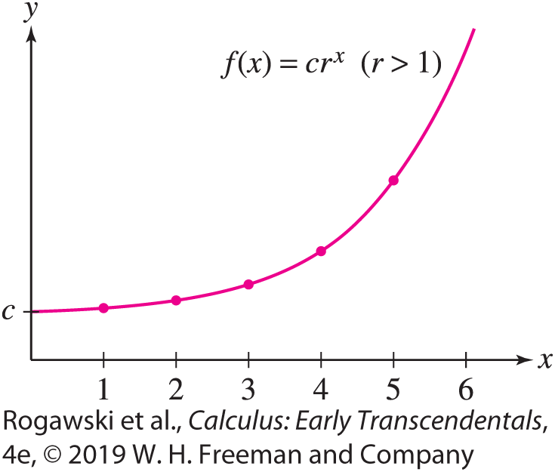

10.1 Sequences (16 of 29)
A geometric sequence is a sequence $a_{n}=cr^{n}$, where c and r are nonzero constants. Each term is r times the previous term; that is, a_{n} /a_{n−1} = r . The number r is called the common ratio. For instance, if r = 3 and c = 2, we obtain the sequence (starting at n = 0)
2, 2· 3, 2· 3², 2· 3³, 2· 3⁴, 2· 3⁵, ...
In the next example, we determine when a geometric series converges. Recall that {a_{n} } diverges to ∞ if the terms a_{n} increase beyond all bounds (Figure 9); that is, $\lim_{n→∞}{a_{n}}=∞$ if, for every number N, a_{n} > N for all sufficiently large n. We define $\lim_{n→∞}{a_{n}}=−∞$ similarly.

Slide 18
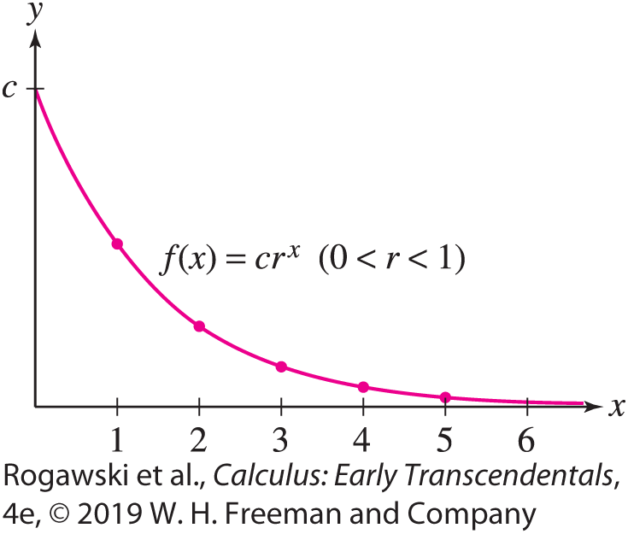

10.1 Sequences (17 of 29)
EX AMPLE: Geometric Sequences with r ≥ 0 Prove that for r ≥ 0 and c > 0,
$$\lim_{n→∞}{cr^{n}}=\left\{\begin{aligned}\begin{matrix} 0 & if & 0≤r<1\end{matrix} \\ \begin{matrix}c & if & r=1\end{matrix} \\ \begin{matrix}∞ & if & r>1\end{matrix}\end{aligned}\right.$$
Solution Set f (x) = cr ^{x} .
If 0 ≤ r < 1, then
$\lim_{n→∞}{cr^{n}}=\lim_{x→∞}{f(x)}=c\lim_{x→∞}{r^{x}}=0$ (Figure 10)
If r > 1, then both f (x) and the sequence {cr^{n} }
diverge to ∞ (because c > 0).
If r = 1, then cr^{n} = c for all n, and the limit is c.

Slide 19


10.1 Sequences (18 of 29)
The limit laws we have used for functions also apply to sequences and are proved similarly.
THEOREM: Limit Laws for Sequences
Assume that {a_{n} } and {b_{n} } are convergent sequences with $\lim_{n→∞}{a_{n}}=L,\lim_{n→∞}{b_{n}}=M.$ Then
(i) $\lim_{n→∞}{(a_{n}±b_{n})}=\lim_{n→∞}{a_{n}}±\lim_{n→∞}{b_{n}}=L±M$
(ii) $\lim_{n→∞}{a_{n}}b_{n}=\left(\lim_{n→∞}{a_{n}}\right)\left(\lim_{n→∞}{b_{n}}\right)=LM$
(iii) $\lim_{n→∞}{\frac{a_{n}}{b_{n}}}=\frac{\lim_{n→∞}{a_{n}}}{\lim_{n→∞}{b_{n}}}=\frac{L}{M} if M≠0$
(iv) $\lim_{n→∞}{{ca}_{n}}=c\lim_{n→∞}{a_{n}} for any constant c$

Slide 20

10.1 Sequences (19 of 29)
THEOREM: Squeeze Theorem for Sequences Let {a_{n} }, {b_{n} }, {c_{n} } be sequences such that, for some number M, b_{n} ≤ a_{n} ≤ c_{n} for n >M .
If $\lim_{n→∞}{b_{n}}=\lim_{n→∞}{c_{n}}=L,$ then $\lim_{n→∞}{a_{n}}=L.$
EXAMPLE: If $\lim_{n→∞}\left|a_{n}\right|=0$, then $\lim_{n→∞}{a_{n}}=0$.
To see this observe that $\lim_{n→∞}\left|a_{n}\right|=0$ implies $\lim_{n→∞}{−\left|a_{n}\right|}=0$. Moreover, $−\left|a_{n}\right|≤a_{n}≤\left|a_{n}\right|$. Therefore, we can apply the Squeeze Theorem to conclude that $\lim_{n→∞}{a_{n}}=0$.

Slide 21

10.1 Sequences (20 of 29)
EX AMPLE: Geometric Sequences with r < 0 For c ≠ 0,
$$\lim_{n→∞}{cr^{n}}=\left\{\begin{aligned}\begin{matrix} 0 & if & −1<r<0\end{matrix} \\ \begin{matrix}diverges & if & r≤−1\end{matrix}\end{aligned}\right.$$
Solution
If −1 < r < 0, then 0 < | r | < 1 and $\lim_{n→∞}{|cr^{n}|}=0.$ By the last example, $\lim_{n→∞}{cr^{n}}=0$.
If r = −1, then the sequence cr^{n} = (−1)^{n} c alternates between c and −c, and therefore does not approach a limit.
The sequence also diverges if r < −1 because | cr^{n} | grows arbitrarily large.

Slide 22
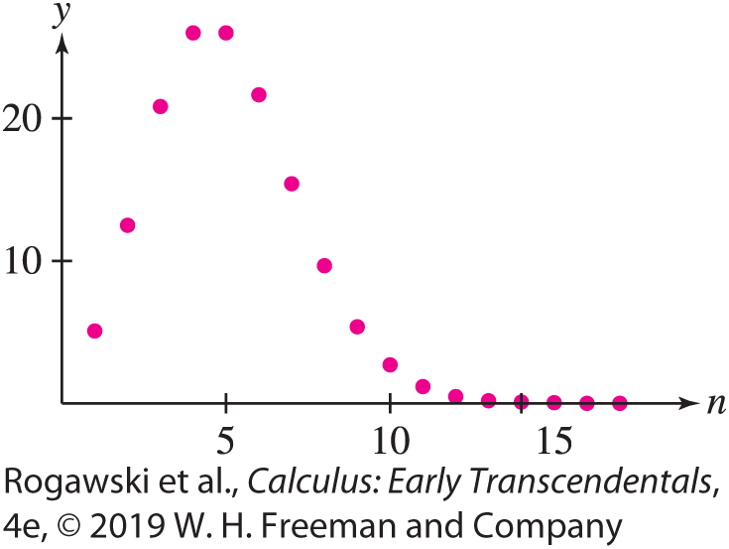

10.1 Sequences (21 of 29)
As another application of the Squeeze Theorem, consider the sequence $a_{n}=\frac{5^{n}}{n!}$. Both the numerator and the denominator grow without bound, so it is not clear in advance whether {a_{n} } converges. Figure 11 suggests that a_{n} increases initially and then tends to zero. In the next example, we verify that a_{n} = R^{n} /n! converges to zero for all real numbers R. This fact is used in the discussion of Taylor series in Section 10.8.

Slide 23

10.1 Sequences (22 of 29)
EX AMPLE: Prove that $\lim_{n→∞}{\frac{R^{n}}{n!}}=0$ for all R.
Solution Assume first that R > 0 and let M be the nonnegative integer with M ≤ R < M +1.
For n > M, we write R^{n} /n! as a product of n factors:
$$\frac{R^{n}}{n!}=\left(\frac{R}{1}\frac{R}{2}⋯\frac{R}{M}\right)\left(\frac{R}{M+1}\right)\left(\frac{R}{M+2}\right)⋯\left(\frac{R}{n}\right)$$
Set $C=\frac{R}{1}\frac{R}{2}⋯\frac{R}{M}$ and observe $\frac{R}{M + 1},\frac{R}{M + 2},⋯,$ $\frac{R}{n}<1$. Then $0≤\frac{R^{n}}{n!}≤\frac{CR}{n}→0.$
By the Squeeze Law, $\lim_{n→∞}{\frac{R^{n}}{n!}}=0$.
If R < 0, the limit is also zero by a previous example because $\frac{{|R|}^{n}}{n!}$ tends to zero.

Slide 24

10.1 Sequences (23 of 29)
THEOREM: Let {a_{n} } be sequence such that $\lim_{n→∞}{a_{n}}=L$. If f is a function which is continuous at L, then the sequence {f (a_{n})} converges and $\lim_{n→∞}{f(a_{n})}=f(L$). In other words, we may pass a limit of a sequence inside a continuous function.
EXAMPLE: The sequence $a_{n}=\frac{3n}{n + 1}= \frac{3n}{n(1 + \left(1/n\right))}=\frac{3}{1 + (1/n)}$ satisfies $\lim_{n→∞}{a_{n}}=3.$
For $f\left(x\right)=e^{x},$ $f\left(a_{n}\right)=e^{a_{n}}=e^{\frac{3n}{n+1}}→f\left(3\right)= e^{3}$ as $n→∞.$
For $g\left(x\right)=x^{2}$, $g\left(a_{n}\right)={\left(a_{n}\right)}^{2}={\left(\frac{3n}{n + 1}\right)}^{2}→9$ as $n→∞.$

Slide 25

10.1 Sequences (24 of 29)
DEFINITION: Bounded Sequences A sequence {a_{n} } is
bounded from above if there is a number M such that a_{n} ≤ M for all n. The number M is called an upper bound.
bounded from below if there is a number m such that a_{n} ≥ m for all n. The number m is called a lower bound.
The sequence {a_{n} } is called bounded if it is bounded from above and below. A sequence that is not bounded is called an unbounded sequence.
For instance, the sequence given by $a_{n}=3−\frac{1}{n}$ is clearly bounded from above by 3. It is also bounded from below by 0, since all the terms are positive. Hence, this sequence is bounded.

Slide 26
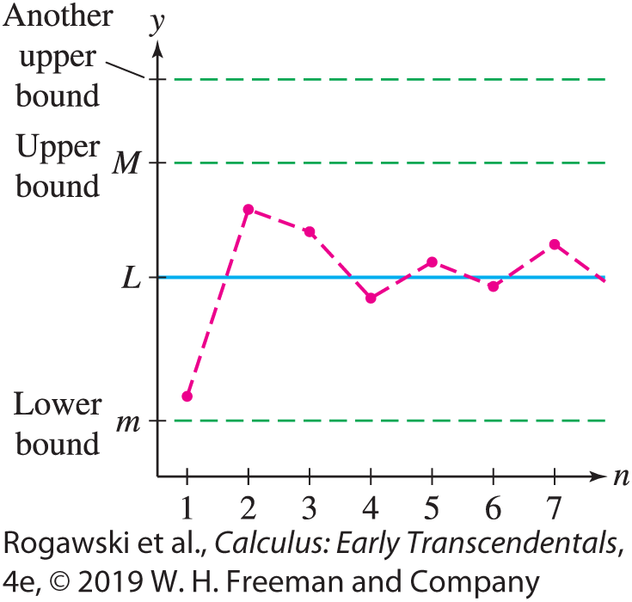
10.1 Sequences (25 of 29)
Upper and lower bounds are not unique. If M is an upper bound, then any number greater than M is also an upper bound, and if m is a lower bound, then any number less than m is also a lower bound (Figure 12).
As we might expect, a convergent sequence {a_{n} } is necessarily bounded because the terms a_{n} get closer and closer to the limit. This fact is stated in the next theorem.
THEOREM: Convergent Sequences Are Bounded If {a_{n} } converges, then {a_{n} } is bounded.

Slide 27

10.1 Sequences (26 of 29)
Proof Let L = $\lim_{n→∞}{a_{n}}$. Then there exists N > 0 such that |a_{n} − L| < 1 for n > N . In other words, L − 1 < a_{n} < L + 1 for n > N. If M is any number greater than L + 1 and also greater than the numbers a₁, a₂, ... , a_{N} , then a_{n} < M for all n. Thus, M is an upper bound. Similarly, any number m less than L − 1 and also less than the numbers a₁, a₂, ... , a_{N} is a lower bound.
There are two ways that a sequence {a_{n} } can diverge.
One way is by being unbounded. For example, the unbounded sequence a_{n} = n diverges: 1, 2, 3, 4, 5, 6, ...
However, a sequence can diverge even if it is bounded. This is the case with a_{n} = (−1)^{n+1}, whose terms a_{n} bounce back and forth but never approach a limit: 1, −1, 1, −1, 1, −1, ...

Slide 28
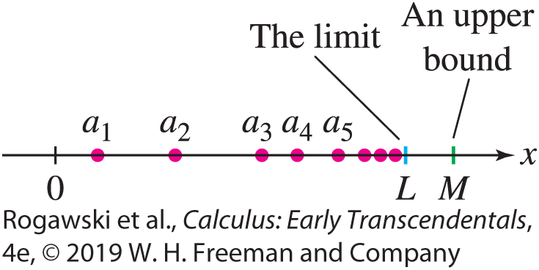
10.1 Sequences (27 of 29)
There is no surefire method for determining whether a sequence {a_{n} } converges, unless the sequence happens to be both bounded and monotonic. By definition, {a_{n} } is monotonic if it is either increasing or decreasing:
{a_{n} } is increasing if a_{n} < a_{n+1} for all n.
{a_{n} } is decreasing if a_{n} > a_{n+1} for all n.
Intuitively, if {a_{n} } is increasing and bounded above by M, then the terms must bunch up near some limiting value L that is not greater than M (Figure 13).

Slide 29

10.1 Sequences (28 of 29)
EXAMPLE:
To see that $a_{n}=\sqrt{n+1}−\sqrt{n}$ is decreasing, consider $f\left(x\right)=\sqrt{x+1}−\sqrt{x}$. Since $f^{′}\left(x\right)=\frac{1}{2\sqrt{x + 1}}−\frac{1}{2\sqrt{x}}<0$ for x > 0, $a_{n}=f(n)$ is decreasing.
Furthermore, a_{n} > 0 for all n, so the sequence has lower bound m = 0. The last theorem guarantees that L = $\lim_{n→∞}$ a_{n} exists and L ≥ 0.
In fact, we can show that L = 0 by noting that f (x) can be rewritten as $f\left(x\right)=\frac{1}{\sqrt{x + 1} + \sqrt{x}}.$ Hence, $\lim_{x→∞}{f\left(x\right)}=0.$

Slide 30

10.1 Sequences (29 of 29)
EXAMPLE: We consider the sequence {$a_{n}\}$, which is defined recursively by $a_{1}=\sqrt{2}$ and $a_{n+1}=\sqrt{2a_{n}}.$ To see that {$a_{n}\}$converges, we show that it is increasing and bounded.
To see that $M=2$ is an upper bound, observe that $a_{1}=\sqrt{2}<2.$ If $a_{n}<2,$then
$$a_{n+1}=\sqrt{2a_{n}}<\sqrt{2∙2}=2$$
Since a_{n} is positive and a_{n} < 2, we have $a_{n+1}=\sqrt{2a_{n}}>\sqrt{a_{n}∙a_{n}}=a_{n}.$This shows that {a_{n} } is increasing.
Since the sequence is bounded above and increasing, we conclude that the limit L exists.
By the Limit Laws, $L=\lim_{n→∞}{a_{n+1}}=\sqrt{2\lim_{n→∞}{a_{n}}}=\sqrt{2L}.$ Hence, $L^{2}=2L$, that is, L = 0 or L = 2. Since $a_{n}≥\sqrt{2}$ for all n, we have L = 2.

Slide 31

10.2 Summing an Infinite Series (1 of 25)
Many quantities that arise in mathematics and its applications cannot be computed exactly. We cannot write an exact decimal expression for the number π or for values of the sine function such as sin 1. However, sometimes these quantities can be represented as infinite sums. For example, using Taylor series (Section 10.8), we can show that
$$\sin{1}=1−\frac{1}{3!}+\frac{1}{5!}−\frac{1}{7!}±⋯ (1)$$
Infinite sums of this type are called infinite series. We think of them as having been obtained by adding up all of the terms in a sequence of numbers.

Slide 32
10.2 Summing an Infinite Series (2 of 25)
But what precisely does Eq. (1) mean? How do we make sense of a sum of infinitely many terms? The idea is to examine finite sums of terms at the start of the series and see how they behave. We add progressively more terms and determine whether or not the sums approach a limiting value. More specifically, for the infinite series
a₁ + a₂ + a₃ + a₄ + ... + a_{n} + ...
define the partial sums:
S₁ = a₁
S₂ = a₁ + a₂
S₃ = a₁ + a₂ + a₃
...
S_{N} = a₁ + a₂ + a₃ + ... + a_{N}

Slide 33
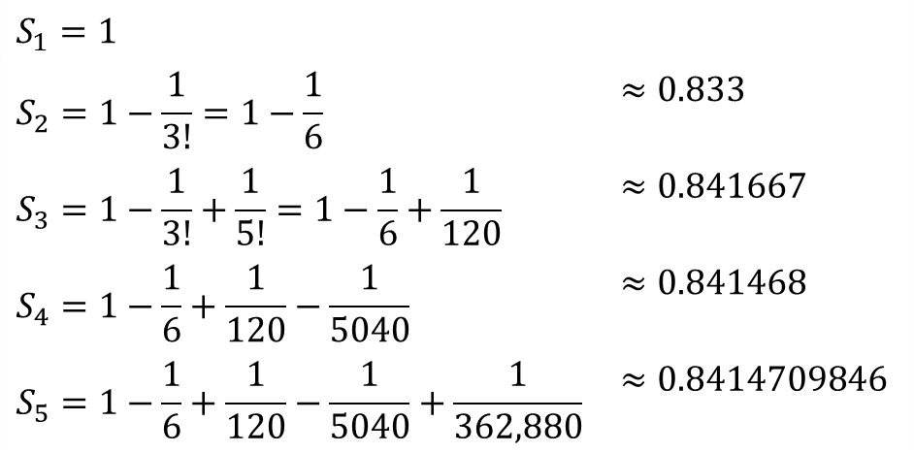
10.2 Summing an Infinite Series (3 of 25)
The idea then is to consider the sequence of values, S₁, S₂, S₃, ... , S_{N} , .. ., and whether the limit of this sequence exists.
For example, here are the first five partial sums of the infinite series for sin 1≈ 0.8414709848 (calculator value):
$$S_{1}=1$$
$$S_{2}=1−\frac{1}{3!}=1−\frac{1}{6}$$ | $$≈0.833$$
$$S_{3}=1−\frac{1}{3!}+\frac{1}{5!}=1−\frac{1}{6}+\frac{1}{120}$$ | $$≈0.841667$$
$$S_{4}=1−\frac{1}{6}+\frac{1}{120}−\frac{1}{5040}$$ | $$≈0.841468$$
$$S_{5}=1−\frac{1}{6}+\frac{1}{120}−\frac{1}{5040}+\frac{1}{362,880}$$ | $$≈0.8414709846$$

Slide 34
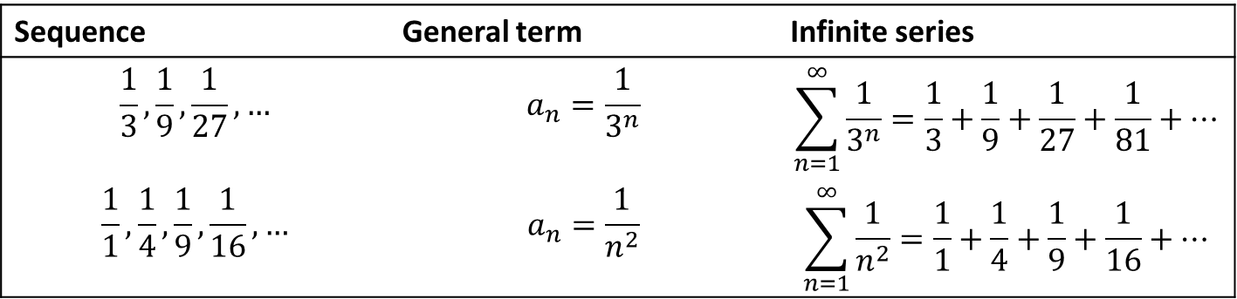

10.2 Summing an Infinite Series (4 of 25)
We see that S₅ differs from sin 1 by less than 10⁻⁹. This suggests that the partial sums converge to sin 1, and in fact, in Section 10.8, we will prove that $\sin{1}=\lim_{n→∞}{S_{n}}$. It makes sense then to define the sum of an infinite series as a limit of partial sums.
In general, an infinite series is an expression of the form
$$\sum_{n=1}^{∞}{a_{n}}=a_{1}+a_{2}+a_{3}+a_{4}+ ⋯$$
where {a_{n} } is any sequence.
Sequence | General term | Infinite series
$$\frac{1}{3}, \frac{1}{9}, \frac{1}{27}, …$$ | $$a_{n}=\frac{1}{3^{n}}$$ | $$\sum_{n=1}^{∞}{\frac{1}{3^{n}}}=\frac{1}{3}+\frac{1}{9}+\frac{1}{27}+\frac{1}{81}+…$$
$$\frac{1}{1}, \frac{1}{4}, \frac{1}{9}, \frac{1}{16},…$$ | $$a_{n}=\frac{1}{n^{2}}$$ | $$\sum_{n=1}^{∞}{\frac{1}{n^{2}}}=\frac{1}{1}+\frac{1}{4}+\frac{1}{9}+\frac{1}{16}+…$$

Slide 35

10.2 Summing an Infinite Series (5 of 25)
The Nth partial sum S_{N} is the finite sum of the terms up to and including a_{N}:
$$S_{N}=\sum_{n=1}^{N}{a_{n}}=a_{1}+a_{2}+a_{3}+ ⋯+a_{N}$$
If the series begins at k, then S_{N} = a_{k} + a_{k+1} + ⋯ +a_{N}.

Slide 36

10.2 Summing an Infinite Series (6 of 25)
DEFINITION: Convergence of an Infinite Series An infinite series $\sum_{n=1}^{∞}{a_{n}}$ converges to the sum S if the sequence of its partial sums {S_{N}} converges to S:
$$\lim_{N→∞}{S_{N}}=S$$
In this case, we write S = $\sum_{n=1}^{∞}{a_{n}}$.
• If the limit does not exist, we say that the infinite series diverges.
• If the limit is infinite, we say that the infinite series diverges to infinity.
We can investigate series numerically by computing several partial sums S_{N}. If the sequence of partial sums appears to converge to some number S, then we have evidence (but not proof) that the series converges to S.

Slide 37

10.2 Summing an Infinite Series (7 of 25)
EXAMPLE: Telescoping Series To investigate
$$\sum_{n=1}^{∞}{\frac{1}{n(n+1)}}=\frac{1}{1∙2}+\frac{1}{2∙3}+\frac{1}{3∙4}+⋯$$
we use the identity $\frac{1}{n(n + 1)}=\frac{1}{n}−\frac{1}{n + 1}$ to simplify each partial sum:
$$S_{1}=\frac{1}{1}−\frac{1}{2}$$
$$S_{2}=\frac{1}{1∙2}+\frac{1}{2∙3}=\frac{1}{1}−\frac{1}{2}+\frac{1}{2}−\frac{1}{3}=1−\frac{1}{3}$$
$$S_{N}=\left(\frac{1}{1}−\frac{1}{2}\right)+\left(\frac{1}{2}−\frac{1}{3}\right)+⋯+\left(\frac{1}{N−1}−\frac{1}{N}\right)+\left(\frac{1}{N}−\frac{1}{N+1}\right)=1−\frac{1}{N+1}$$

Slide 38

10.2 Summing an Infinite Series (8 of 25)
The sum S is the limit of the sequence of partial sums:
$$S=\lim_{N→∞}{S_{N}}=\lim_{N→∞}\left(1−\frac{1}{N+1}\right)=1$$
It is important to keep in mind the difference between a sequence {a_{n}} and an infinite
series
$$\sum_{n=1}^{∞}{a_{n}}$$
EXAMPLE: Sequences Versus Series Discuss the difference between {a_{n}} and $\sum_{n=1}^{∞}{a_{n}}$ where $a_{n}=\frac{1}{n(n + 1)}$.

Slide 39

10.2 Summing an Infinite Series (9 of 25)
Solution
The sequence is the list of numbers $\frac{1}{1 ∙ 2}, \frac{1}{2 ∙ 3}, \frac{1}{3 ∙ 4}, ⋯.$ This sequence converges to zero: $\lim_{n→∞}{a_{n}}=\lim_{n→∞}{\frac{1}{n(n + 1)}}=0.$
The infinite series is the sum of the numbers a_{n}, defined formally as the limit of the sequence of partial sums. This sum is not zero. In fact, the sum is equal to 1 by the last example:
$$\sum_{n=1}^{∞}{\frac{1}{n(n+1)}}=1$$

Slide 40

10.2 Summing an Infinite Series (10 of 25)
THEOREM: Linearity of Infinite Series If $\sum_{n=1}^{∞}{a_{n}}$ and $\sum_{n=1}^{∞}{b_{n}}$ converge, then the sequences $\sum_{n=1}^{∞}{(a_{n}+b_{n}})$, $\sum_{n=1}^{∞}{(a_{n}−b_{n}})$, and $\sum_{n=1}^{∞}{ca_{n}}$ also converge, the latter for any constant c. Furthermore,
$$\sum_{n=1}^{∞}{(a_{n}+b_{n}})=\sum_{n=1}^{∞}{a_{n}+}\sum_{n=1}^{∞}{b_{n}}$$
$$\sum_{n=1}^{∞}{(a_{n}−b_{n}})=\sum_{n=1}^{∞}{a_{n}−}\sum_{n=1}^{∞}{b_{n}}$$
$$\sum_{n=1}^{∞}{ca_{n}}=c\sum_{n=1}^{∞}{a_{n}} \left(c any constant\right)$$
These rules follow from the corresponding linearity rules for limits.

Slide 41

10.2 Summing an Infinite Series (11 of 25)
A main goal in this chapter is to develop techniques for determining whether a series
converges or diverges. It is easy to give examples of series that diverge:
$\sum_{n=1}^{∞}{1}$ diverges to infinity (the partial sums increase without bound):
S₁ = 1, S₂ = 1 + 1 = 2, S₃ = 1 + 1 + 1 = 3, S₄ = 1 + 1 + 1 + 1 = 4, . . .
$\sum_{n=1}^{∞}{{(−1)}^{n−1}}$ diverges (the partial sums jump between 1 and 0):
S₁ = 1, S₂ = 1 − 1 = 0, S₃ = 1 − 1 + 1 = 1, S₄ = 1 − 1 + 1 − 1 = 0, . . .

Slide 42

10.2 Summing an Infinite Series (12 of 25)
Next, we study geometric series, which converge or diverge depending on the common ratio r .
A geometric series with common ratio r ≠ 0 is a series defined by a geometric sequence cr^{n}, where c ≠ 0. If the series begins at n = 0, then
$$\sum_{n=0}^{∞}{cr^{n}}==c+cr+cr^{2}+cr^{3}+⋯$$

Slide 43
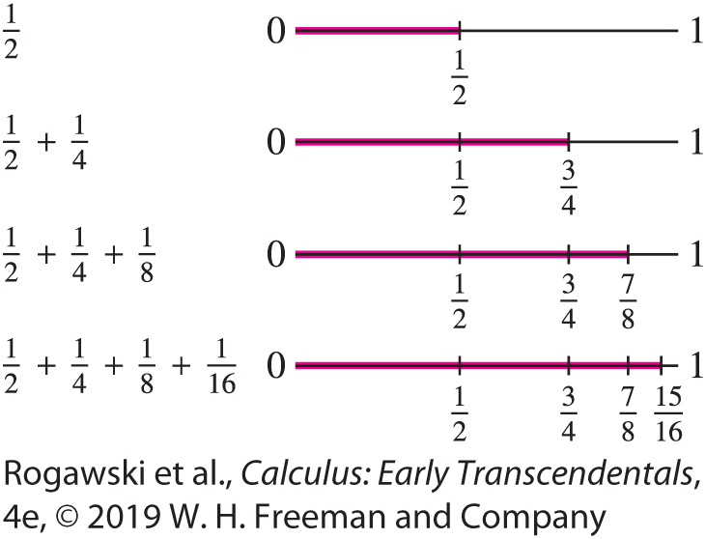

10.2 Summing an Infinite Series (13 of 25)
For $r=\frac{1}{2}$ and c = 1, we have the following series:
$\sum_{n=1}^{∞}{\frac{1}{2^{n}}}=\frac{1}{2}+\frac{1}{4}+\frac{1}{8}+\frac{1}{16}+⋯$
The figure demonstrates that adding successive terms in the series corresponds to moving stepwise from 0 to 1, where each step is a move to the right by half of the remaining distance. Thus, it appears that the series converges to 1.

Slide 44

10.2 Summing an Infinite Series (14 of 25)
THEOREM: Partial Sums of a Geometric Series For the geometric series $\sum_{n=0}^{∞}{cr^{n}}$ with r ≠ 1, we have
$$S_{N}=c+cr+cr^{2}+cr^{3}+⋯+cr^{N}=\frac{c\left(1−r^{N+1}\right)}{1−r} \left(3\right)$$
Proof $S_{N}=c+cr+cr^{2}+cr^{3}+⋯+cr^{N}$ and ${rS}_{N}=cr+cr^{2}+⋯+cr^{N}+cr^{N+1}$. So,
$$\left(1−r\right)S_{N}=c−cr^{N+1} or S_{N}=\frac{c\left(1−r^{N+1}\right)}{1−r}$$
since r ≠ 1.

Slide 45

10.2 Summing an Infinite Series (15 of 25)
This partial sum formula enables us to compute the sum of the geometric series when |r| < 1.
THEOREM : Sum of a Geometric Series Let c ≠ 0. If | r | < 1, then
$$\sum_{n=0}^{∞}{cr^{n}}=c+cr+cr^{2}+cr^{3}=\frac{c}{1−r} (4)$$
If |r|≥ 1, then the geometric series diverges.

Slide 46

10.2 Summing an Infinite Series (16 of 25)
Proof
If r = 1, then the series certainly diverges because the partial sums S_{N} = Nc grow arbitrarily large.
If r ≠ 1, then Eq. (3) yields
$$\lim_{N→∞}{S_{N}}=\lim_{N→∞}{\frac{c(1−r^{N+1})}{1−r}}=\frac{c}{1−r}−\frac{c}{1−r}\lim_{N→∞}{r^{N+1}}$$
If |r | < 1, then $\lim_{N→∞}{r^{N+1}}=0$ and we obtain Eq. (4).
If | r |≥ 1 and r ≠ 1, then $\lim_{N→∞}{r^{N+1}}$ does not exist and the geometric series diverges.

Slide 47

10.2 Summing an Infinite Series (17 of 25)
EXAMPLE:
a) $\sum_{n=0}^{∞}{5^{−n}}$ is a geometric series with common ratio r = 5⁻¹ and first term c = 1. By Eq. (4), $\sum_{n=0}^{∞}{5^{−n}}=\frac{1}{1 − 5^{−1}}=\frac{5}{4}.$
b) $\sum_{n=3}^{∞}{7{\left(−\frac{3}{4}\right)}^{n}}$ is a geometric series with common ratio $r=−\frac{3}{4}$ and first term
$c=7{\left(−\frac{3}{4}\right)}^{3}$. Therefore, it converges to
$$\frac{c}{1−r}=\frac{7{\left(−\frac{3}{4}\right)}^{3}}{1+\frac{3}{4}}=−\frac{27}{16}$$

Slide 48

10.2 Summing an Infinite Series (18 of 25)
EX AMPLE: Find a fraction that has repeated decimal expansion 0.212121 ... .
Solution We can write this decimal as the series
$\frac{21}{100}+\frac{21}{{100}^{2}}+\frac{21}{{100}^{3}}+⋯$
This is a geometric series with $c=\frac{21}{100}$and $r= \frac{1}{100}$. Thus, it converges to
$$\frac{c}{1−r}=\frac{\frac{21}{100}}{1−\frac{1}{100}}=\frac{21}{99}=\frac{7}{33}$$

Slide 49
10.2 Summing an Infinite Series (19 of 25)
EXAMPLE: A Probability Computation Nina and Brook are participating in an archery competition where they take turns shooting at a target. The first one to hit the bullseye wins. Nina’s success rate hitting the bullseye is 45% while Brook’s is 52%. Nina pointed out this difference, arguing that she should go first. Brook agreed to give the first turn to Nina. Should he have?

Slide 50
10.2 Summing an Infinite Series (20 of 25)
Solution We can answer this question by determining the probability that Nina wins the competition. It is done via a geometric series.
Nina wins in each of the following cases.
By hitting the bullseye on her first turn (which happens with probability 0.45), or
By having both players miss on their first turn and Nina hit on her second turn [which happens with probability (0.55)(0.48)(0.45)], or
By having both players miss on their first two turns and Nina hit on her third [which happens with probability (0.55)(0.48)(0.55)(0.48)(0.45)], and so on...

Slide 51

10.2 Summing an Infinite Series (21 of 25)
There are infinitely many different cases that result in a win for Nina, and because they are distinct from each other (i.e., no two of them can occur at the same time) the probability that some one of them occurs is the sum of each of the individual probabilities. That is, the probability that Nina hits the bullseye first is
0.45 + (0.55)(0.48)(0.45) + (0.55)²(0.48)²(0.45) + ...
This is a geometric series with c = 0.45 and r = (0.55)(0.48) = 0.264. It follows that the probability that Nina wins is $\frac{0.45}{1 − 0.264}≈0.61$. Thus, Brook would have been wise not to let Nina go first.

Slide 52

10.2 Summing an Infinite Series (22 of 25)
EXAMPLE:
$$\sum_{n=0}^{∞}{\frac{2+3^{n}}{5^{n}}}=\sum_{n=0}^{∞}{\left[2{\left(\frac{1}{5}\right)}^{n}+{\left(\frac{3}{5}\right)}^{n}\right]}=2\sum_{n=0}^{∞}{{\left(\frac{1}{5}\right)}^{n}}+\sum_{n=0}^{∞}{{\left(\frac{3}{5}\right)}^{n}}$$
$$=2\frac{1}{1−\frac{1}{5}}+\frac{1}{1−\frac{3}{5}}=5$$

Slide 53

10.2 Summing an Infinite Series (23 of 25)
The infinite series $\sum_{n=1}^{∞}{1}$ diverges because the Nth partial sum S_{N} = N diverges to infinity. It is less clear whether the following series converges or diverges:
$$\sum_{n=1}^{∞}{{(−1)}^{n+1}\frac{n}{n+1}}=\frac{1}{2}−\frac{2}{3}+\frac{3}{4}−\frac{4}{5}±⋯$$
We now introduce a useful test that allows us to conclude that this series diverges. The idea is that if the terms are not shrinking to 0 in size, then the series will not converge. This is typically the first test one applies when attempting to determine whether a series diverges.
THEOREM: nth Term Divergence Test If $\lim_{n→∞}{a_{n}}≠0$, then the series $\sum_{n=1}^{∞}{a_{n}}$ diverges.
Proof If $\sum_{n=1}^{∞}{a_{n}}$ converges, then let S = $\lim_{n→∞}{S_{n}}$. Thus,
$$\lim_{n→∞}{a_{n}}=\lim_{n→∞}{S_{n}}−\lim_{n→∞}{S_{n−1}}=S −S=0$$

Slide 54

10.2 Summing an Infinite Series (24 of 25)
EXAMPLE:
$\sum_{n=1}^{∞}{\frac{n}{4n + 1}}$ diverges since $\lim_{n→∞}{a_{n}}=\lim_{n→∞}{\frac{n}{4n + 1}}=\lim_{n→∞}{\frac{1}{\frac{4+1}{n}}}= \frac{1}{4}.$
$\sum_{n=1}^{∞}{{(−1)}^{n+1}\frac{n}{n + 1}}$diverges since $\lim_{n→∞}{\frac{n}{n + 1}}=1.$ Thus, $a_{2n+1}→−1$as $n→∞$, and $a_{2n}→1$ as $n→∞$. Therefore, $\lim_{n→∞}{a_{n}}$ does not exist.
The nth Term Divergence Test tells only part of the story. If a_{n} does not tend to zero, then $\sum_{n=1}^{∞}{a_{n}}$ certainly diverges. But what if a_{n} does tend to zero? In this case, the series may converge or it may diverge. In other words, $\lim_{n→∞}{a_{n}}$= 0 is a necessary condition of convergence, but it is not sufficient. As we show in the next example, it is possible for a series to diverge even though its terms tend to zero.

Slide 55

10.2 Summing an Infinite Series (25 of 25)
EXAMPLE: The series
$$\sum_{n=1}^{∞}{\frac{1}{\sqrt{n}}}=\frac{1}{\sqrt{1}}+\frac{1}{\sqrt{2}}+\frac{1}{\sqrt{3}}+⋯$$
diverges since
$$S_{N}=\sum_{n=1}^{N}{\frac{1}{\sqrt{n}}}≥\sum_{n=1}^{N}{\frac{1}{\sqrt{N}}}=N\frac{1}{\sqrt{N}}=\sqrt{N}→∞$$
as n →∞. Thus, S_{N} → ∞ as n →∞.

Slide 56
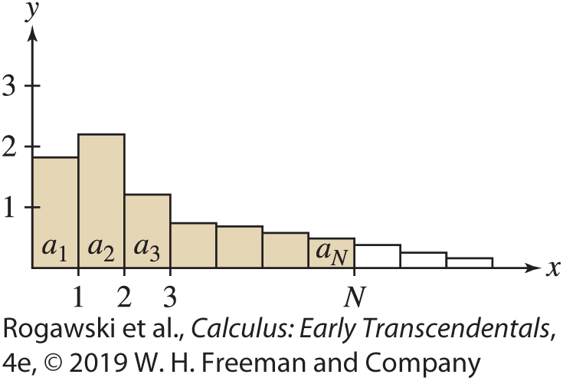

10.3 Convergence of Series with Positive Terms (1 of 18)
In this section, we consider positive series $\sum{a_{n}}$, where a_{n} > 0 for all n. We can visualize the terms of a positive series as rectangles of width 1 and height a_{n} (Figure 1). The partial sum
S_{N} = a₁ + a₂ + ··· + a_{N}
is equal to the area of the first N rectangles.

Slide 57

10.3 Convergence of Series with Positive Terms (2 of 18)
The key feature of positive series is that their partial sums form an increasing sequence
S_{N} < S_{N+1} for all N. This is because S_{N+1} is obtained from S_{N} by adding a positive number:
S_{N+1} = (a₁ + a₂ + ··· + a_{N} ) + a_{N +1} = S_{N} + a_{N+1} ≥ S_{N}
Recall that an increasing sequence converges if it is bounded above. Otherwise, it diverges (Section 10.1). It follows that a positive series behaves in one of two ways.
THEOREM: Partial Sum Theorem for Positive Series If $\sum{a_{n}}$ is a positive series, then either
(i) The partial sums S_{N} are bounded above. In this case, $\sum_{n=1}^{∞}{a_{n}}$ converges, or
(ii) The partial sums S_{N} are not bounded above. In this case, $\sum_{n=1}^{∞}{a_{n}}$ diverges.

Slide 58

10.3 Convergence of Series with Positive Terms (3 of 18)
The last theorem remains true if a_{n} ≥ 0. It is not necessary to assume that a_{n} > 0.
It also remains true if a_{n} > 0 for all n ≥ M for some M, because the convergence or divergence of a series is not affected by the first M terms.
Assumptions Matter The theorem does not hold for nonpositive series. Consider
$$\sum_{n=1}^{∞}{{(−1)}^{n−1}}=1−1+1−1±⋯$$
The partial sums are bounded (because S_{N} = 1 or 0), but the series diverges.

Slide 59

10.3 Convergence of Series with Positive Terms (4 of 18)
Our first application of the last theorem is the following Integral Test. It is extremely useful because in many cases, integrals are easier to evaluate than series.
THEOREM: Integral Test Let a_{n} = f (n), where f is a positive, decreasing, and continuous function of x for x ≥ 1.
(i) If $\int_{1}^{∞}{f\left(x\right)dx}$ converges, then $\sum_{n=1}^{∞}{a_{n}}$ converges.
(ii) If $\int_{1}^{∞}{f\left(x\right)dx}$ diverges, then $\sum_{n=1}^{∞}{a_{n}}$ diverges.

Slide 60
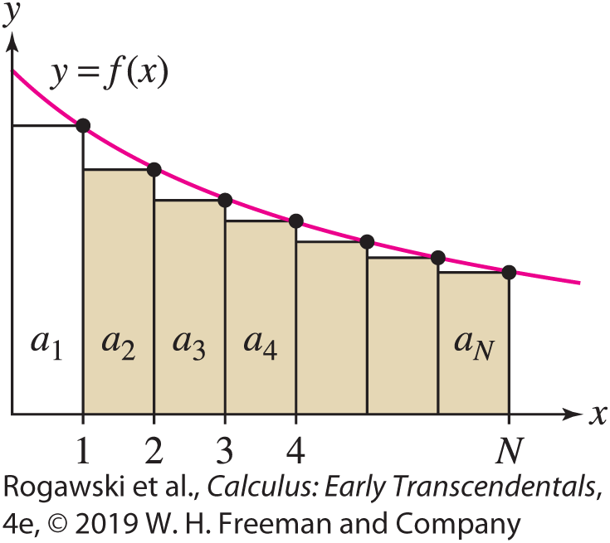

10.3 Convergence of Series with Positive Terms (5 of 18)
Proof Because f is decreasing, the shaded rectangles in Figure 2 lie below the graph of f , and therefore, for all N,
$$a_{2}+⋯+a_{n}≤\int_{1}^{N}{f\left(x\right)dx}≤\int_{1}^{∞}{f\left(x\right)dx}$$
If the improper integral on the right converges, then the sums a₂ + ··· + a_{N} are bounded above. That is, the partial sums S_{N} are bounded above, and therefore the infinite series converges by the Partial Sum Theorem for Positive Series. This proves (i).

Slide 61
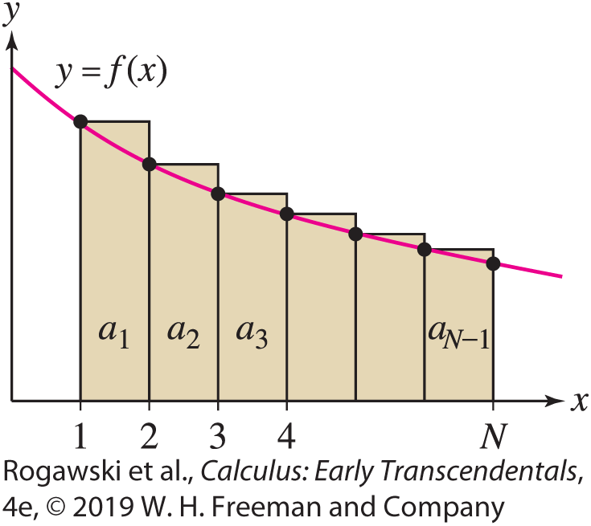

10.3 Convergence of Series with Positive Terms (6 of 18)
On the other hand, the rectangles in Figure 3 lie above the graph of f , so
$$\int_{1}^{N}{f\left(x\right)dx}≤a_{1}+a_{2}+⋯a_{N}$$
If $\int_{1}^{∞}{f\left(x\right)dx}$ diverges, then $\int_{1}^{N}{f\left(x\right)dx}$ increases without bound as N increases. The inequality in (1) shows that S_{N} also increases without bound, and therefore the series diverges. This proves (ii).

Slide 62

10.3 Convergence of Series with Positive Terms (7 of 18)
EX AMPLE: The Harmonic Series Diverges We show that $\sum_{n=1}^{∞}{\frac{1}{n}}$ diverges by considering the function $f\left(x\right)=\frac{1}{x}$ since $f\left(n\right)=\frac{1}{n}$. The Integral Test applies because f is positive, decreasing, and continuous for x ≥ 1. The integral diverges:
$$\int_{1}^{∞}{\frac{dx}{x}}=\lim_{R→∞}{\int_{1}^{R}{\frac{dx}{x}}}=\lim_{R→∞}{\ln{R}}=∞$$
Therefore, the series $\sum_{n=1}^{∞}{\frac{1}{n}}$ diverges.

Slide 63

10.3 Convergence of Series with Positive Terms (8 of 18)
EXAMPLE: We investigate whether or not $\sum_{n=1}^{∞}{\frac{n}{{\left(n^{2}+ 1\right)}^{2}}}$converges. For this, we consider the function $f\left(x\right)=\frac{x}{{\left(x^{2}+ 1\right)}^{2}}$, which is positive and continuous for x ≥ 1. It is decreasing because $f^{′}\left(x\right)=\frac{1 − 3x^{2}}{{\left(x^{2}+ 1\right)}^{3}}<0$ for x ≥ 1. Therefore, the Integral Test applies. Using the substitution u = x ² + 1, du = 2x d x , we have
$$\int_{1}^{∞}{\frac{x}{{\left(x^{2}+1\right)}^{2}}}dx=\lim_{R→∞}{\int_{1}^{R}{\frac{x}{{\left(x^{2}+1\right)}^{2}}}dx=\lim_{R→∞}{\frac{1}{2}\int_{2}^{R^{2}+1}{\frac{du}{u^{2}}}}}$$
$$=\lim_{R→∞}{\frac{−1}{2u}|_{2}^{R^{2}+1}}=\lim_{R→∞}\left(\frac{1}{4}−\frac{1}{2(R^{2}+1)}\right)=\frac{1}{4}$$
Thus, the integral converges, and therefore $\sum_{n=1}^{∞}{\frac{n}{{\left(n^{2}+ 1\right)}^{2}}}$converges by the Integral Test.

Slide 64

10.3 Convergence of Series with Positive Terms (9 of 18)
The sum of the reciprocal powers n^{− p} is called a p-series. As the next theorem shows, the convergence or divergence of these series is determined by the value of p.
THEOREM: Convergence of p-Series The infinite series $\sum_{n=1}^{∞}{\frac{1}{n^{p}}}$ converges if p > 1 and diverges otherwise.
Proof If p ≤ 0, then the general term n^{− p} does not tend to zero, so the series diverges by the Test for Divergence Test. If p > 0, then f (x) = x ^{− p} is positive and decreasing for x ≥ 1, so the Integral Test applies. According to in Section 7.7, $\int_{1}^{∞}{\frac{1}{x^{p}}dx}$ converges exactly if p >1.

Slide 65

10.3 Convergence of Series with Positive Terms (10 of 18)
Here are two examples of p-series:
$$\sum_{n=1}^{∞}{\frac{1}{\sqrt[3]{n}}}=\sum_{n=1}^{∞}{\frac{1}{n^{1/3}}} diverges since p=\frac{1}{3}<1.$$
$$\sum_{n=1}^{∞}{\frac{1}{n^{2}}} converges since p=2>1.$$

Slide 66
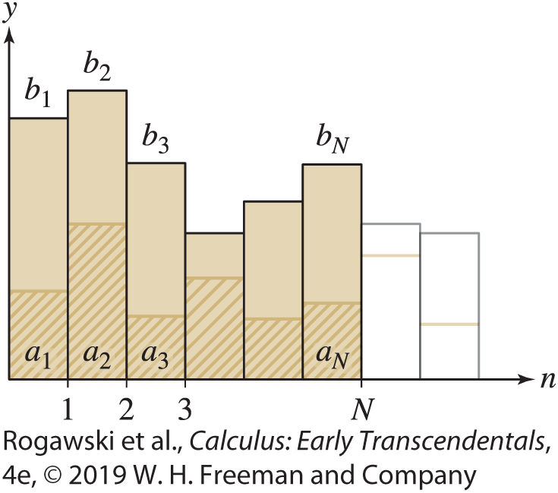


10.3 Convergence of Series with Positive Terms (11 of 18)
Another powerful method for determining convergence of positive series occurs via
comparison with other series. Suppose that 0 ≤ a_{n} ≤ b_{n}. Figure 4 suggests that if the larger sum $\sum{b_{n}}$converges, then the smaller sum $\sum{a_{n}}$ also converges. Similarly, if the smaller sum diverges, then the larger sum also diverges.
THEOREM : Direct Comparison Test
Assume that there exists M > 0 such that 0 ≤ a_{n} ≤ b_{n} for n ≥ M.
(i) If $\sum_{n=1}^{∞}{b_{n}}$ converges, then $\sum_{n=1}^{∞}{a_{n}}$ also converges.
(ii) If $\sum_{n=1}^{∞}{a_{n}}$ diverges, then $\sum_{n=1}^{∞}{b_{n}}$ also diverges.

Slide 67

10.3 Convergence of Series with Positive Terms (12 of 18)
Proof We can assume, without loss of generality, that M = 1.
If $\sum_{n=1}^{∞}{b_{n}}$ converges, then $\sum_{n=1}^{N}{a_{n}}≤\sum_{n=1}^{N}{b_{n}}≤\sum_{n=1}^{∞}{b_{n}}=S<∞$. Therefore, $\sum_{n=1}^{∞}{a_{n}}$ by the Partial Sum Theorem for Positive Series. This proves (i).
On the other hand, if $\sum_{n=1}^{∞}{a_{n}}$diverges, then $\sum_{n=1}^{∞}{b_{n}}$ must also diverge. Otherwise, we would have a contradiction to (i).

Slide 68

10.3 Convergence of Series with Positive Terms (13 of 18)
EXAMPLE:
$\sum_{n=1}^{∞}{\frac{1}{\sqrt{n}3^{n}}}$ converges by the direct comparison test since $\frac{1}{\sqrt{n}3^{n}}≤\frac{1}{3^{n}}$ and $\sum_{n=1}^{∞}{\frac{1}{3^{n}}}$ is a convergent geometric series with $r=\frac{1}{3}$.
$\sum_{n=1}^{∞}{\frac{1}{{\left(n^{2}+ 3\right)}^{1/3}}}$ diverges by the direct comparison test since $n^{2}+3≤2n^{2}$ for $n≥2$. Hence, $\frac{1}{{\left(n^{2}+ 3\right)}^{1/3}}≥\frac{1}{{\left(2n^{2}\right)}^{1/3}}≥2^{−1/3}\frac{1}{n^{2/3}}$ and $\sum_{n=1}^{∞}{\frac{1}{n^{2/3}}}$ diverges since $p=\frac{2}{3}<1.$

Slide 69

10.3 Convergence of Series with Positive Terms (14 of 18)
EXAMPLE: To determine the convergence of $\sum_{n=2}^{∞}{\frac{1}{n\ln^{2}{n}}}$, we may be tempted to use the estimate $\frac{1}{n\ln^{2}{n}}≤\frac{1}{n}$. However, the fact that $\sum_{n=2}^{∞}{\frac{1}{n}}$ diverges says nothing about the smaller series.
On the other hand,
$$\int_{2}^{∞}{\frac{1}{x\ln^{2}{x}}}dx=\lim_{R→∞}{\int_{2}^{r}{\frac{1}{x\ln^{2}{x}}}dx}=\lim_{R→∞}{−\frac{1}{\ln{x}}|_{2}^{R}}=\lim_{R→∞}\left(\frac{1}{\ln{2}}−\frac{1}{\ln{R}}\right)=\frac{1}{\ln{2}}$$
Therefore, $\sum_{n=2}^{∞}{\frac{1}{n\ln^{2}{n}}}$ converges by the Integral Test since $f\left(x\right)=\frac{1}{x\ln^{2}{x}}$ satisfies its hypotheses.

Slide 70

10.3 Convergence of Series with Positive Terms (15 of 18)
THEOREM: Limit Comparison Test
Let {a_{n} } and {b_{n} } be positive sequences. Assume that the following limit exists:
$$L=\lim_{n→∞}{\frac{a_{n}}{b_{n}}}$$
If L > 0, then $\sum_{n=1}^{∞}{a_{n}}$ converges if and only if $\sum_{n=1}^{∞}{b_{n}}$ converges.
If L =∞ and $\sum_{n=1}^{∞}{a_{n}}$ converges, then $\sum_{n=1}^{∞}{b_{n}}$converges.
If L = 0 and $\sum_{n=1}^{∞}{b_{n}}$converges, then $\sum_{n=1}^{∞}{a_{n}}$ converges.

Slide 71

10.3 Convergence of Series with Positive Terms (16 of 18)
Proof Assume first that L is finite (possibly zero) and that $\sum_{n=1}^{∞}{b_{n}}$ converges. Choose a positive number R > L. Then 0 ≤ a_{n} /b_{n} ≤ R for all n sufficiently large because a_{n} /b_{n} approaches L. Therefore, a_{n} ≤ Rb_{n}. The series $\sum_{n=1}^{∞}{{Rb}_{n}}$ converges because it is a constant multiple of the convergent series $\sum_{n=1}^{∞}{b_{n}}$. Thus, $\sum_{n=1}^{∞}{a_{n}}$ converges by the Direct Comparison Test.
Next, suppose that L ≠ 0 (positive or infinite) and that $\sum_{n=1}^{∞}{a_{n}}$ converges. Let $K=\lim_{n→∞}{\frac{b_{n}}{a_{n}}}$. Then either K = L⁻¹ (if L is finite) or K = 0 (if L is infinite). In either case, K is finite and we can apply the result of the previous paragraph with the roles of {a_{n} } and {b_{n} } reversed to conclude that $\sum_{n=1}^{∞}{b_{n}}$converges.

Slide 72

10.3 Convergence of Series with Positive Terms (17 of 18)
EXAMPLE: To show that $\sum_{n=2}^{∞}{\frac{n^{2}}{n^{4} − n − 1}}$ converges, we observe that $\frac{n^{2}}{n^{4} − n − 1}≈\frac{1}{n^{2}}$ for large n. Therefore, we consider
$$\lim_{n→∞}{\frac{{n^{2}}/{(n^{4}−n−1)}}{1/{n^{2}}}}=\lim_{n→∞}{\frac{n^{4}}{n^{4}−n−1}}=\lim_{n→∞}{\frac{1}{1−1/{n^{3}}−1/{n^{4}}}}=1.$$
Since $\sum_{n=1}^{∞}{\frac{1}{n^{2}}}$ converges because of $p=2>1$, we obtain that $\sum_{n=2}^{∞}{\frac{n^{2}}{n^{4} − n − 1}}$ converges by the Limit Comparison Test.

Slide 73

10.3 Convergence of Series with Positive Terms (18 of 18)
EXAMPLE: To show that $\sum_{n=1}^{∞}{\frac{1}{\sqrt{n^{2}+ 4}}}$ diverges, we consider $a_{n}=\frac{1}{\sqrt{n^{2}+ 4}}$ and $b_{n}=\frac{1}{n}$. We know that $\sum_{n=1}^{∞}{\frac{1}{n}}$diverges. Since
$$\lim_{n→∞}{\frac{1/{\sqrt{n^{2}+4}}}{1/n}}=\lim_{n→∞}{\frac{n}{\sqrt{n^{2}+4}}}=\lim_{n→∞}{\frac{1}{\sqrt{1+4/{n^{2}}}}}=1$$
we obtain that $\sum_{n=1}^{∞}{\frac{1}{\sqrt{n^{2}+ 4}}}$ diverges by the Limit Comparison Test.
In the Limit Comparison Test, when attempting to find an appropriate b_{n} to compare with a_{n} , we typically keep only the largest power of n in the numerator and denominator of a_{n} , as we did in each of the previous examples.

Slide 74

10.4 Absolute and Conditional Convergence (1 of 11)
In the previous section, we studied positive series, but we still lack the tools to analyze series with both positive and negative terms. One of the keys to understanding such series is the concept of absolute convergence.
DEFINITION: Absolute Convergence The series $\sum_{n=1}^{∞}{a_{n}}$ converges absolutely if $\sum_{n=1}^{∞}{{|a}_{n}|}$ converges.
EXAMPLE: The series $\sum_{n=1}^{∞}{\frac{{(−1)}^{n−1}}{n^{2}}}$ converges absolutely since $\left|\frac{{(−1)}^{n−1}}{n^{2}}\right|=\frac{1}{n^{2}}$ and $\sum_{n=1}^{∞}{\frac{1}{n^{2}}}$ converges.

Slide 75

10.4 Absolute and Conditional Convergence (2 of 11)
THEOREM : Absolute Convergence Implies Convergence
If $\sum_{n=1}^{∞}{|a_{n}|}$ converges, then $\sum_{n=1}^{∞}{a_{n}}$ also converges.
Proof We have $−|a_{n}|≤a_{n}≤|a_{n}|$. By adding | a_{n} | to all parts of the inequality, we get the inequalities 0 ≤ | a_{n} |+ a_{n} ≤ 2| a_{n}|. If $\sum_{n=1}^{∞}{| a_{n}|}$converges, then $\sum_{n=1}^{∞}{2|{ a}_{n}|}$ also converges, and therefore $\sum_{n=1}^{∞}{(a_{n}+|{ a}_{n}|})$converges by the Direct Comparison Test. Our original series converges because it is the difference of two convergent series:
$$\sum_{n=1}^{∞}{a_{n}}=\sum_{n=1}^{∞}{(a_{n}+|a_{n}|})−\sum_{n=1}^{∞}{|a_{n}|}$$

Slide 76

10.4 Absolute and Conditional Convergence (3 of 11)
EXAMPLE:
We showed that $\sum_{n=1}^{∞}{\frac{{(−1)}^{n−1}}{n^{2}}}$ converges absolutely. By the last theorem, it converges.
The series $\sum_{n=1}^{∞}{\frac{{(−1)}^{n−1}}{\sqrt{n}}}$does not converge absolutely since $\sum_{n=1}^{∞}{\frac{1}{\sqrt{n}}}$ diverges because $p=\frac{1}{2}≤1.$
The series in the previous example does not converge absolutely, but we still do not know whether or not it converges. A series $\sum_{n=1}^{∞}{a_{n}}$ may converge without converging absolutely.
DEFINITION: A series $\sum_{n=1}^{∞}{a_{n}}$ is conditionally convergent if it converges, but is not absolutely convergent.

Slide 77
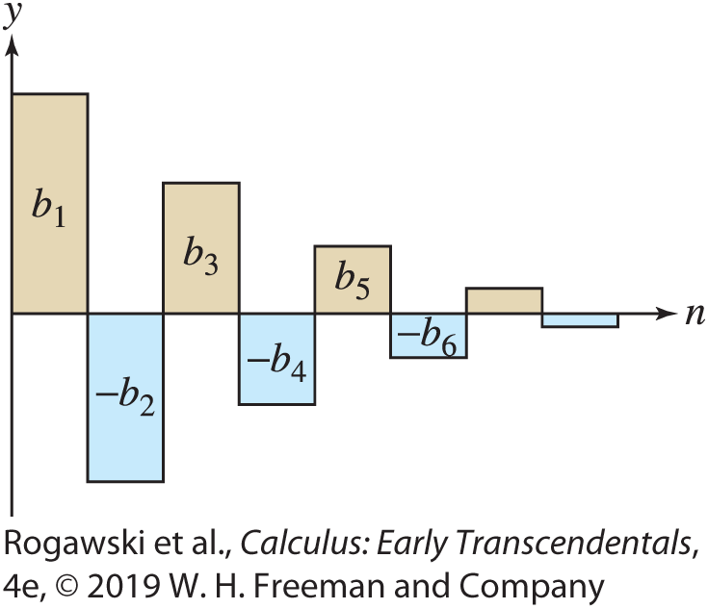

10.4 Absolute and Conditional Convergence (4 of 11)
If a series is not absolutely convergent, how can we determine whether it is conditionally convergent? This is often a difficult question, because we cannot use the Integral Test or the Direct Comparison Test since they apply only to positive series. However, convergence is guaranteed in the particular case of an alternating series
$$\sum_{n=1}^{∞}{{(−1)}^{n−1}}b_{n}= b_{1}−b_{2}+b_{3}−b_{4}±⋯$$
where the terms b_{n} are positive and decrease to zero (Figure 1).

Slide 78

10.4 Absolute and Conditional Convergence (5 of 11)
THEOREM: Alternating Series Test Assume that {b_{n}} is a positive sequence that is decreasing and converges to 0:
$$\text{b}\text{1} \text{>} \text{b}\text{2} \text{>} \text{b}\text{3} \text{>} \text{b}\text{4} \text{>} \text{··}\text{·} \text{>} \text{0,} \lim_{n→∞}{b_{n}}=0$$
Then the series $\sum_{n=1}^{∞}{{(−1)}^{n−1}b_{n}}$ converges.
Moreover, if $S=\sum_{n=1}^{∞}{{(−1)}^{n−1}b_{n}}$, then 0 < S < b₁ and S_{p} < S < S_{q} for p even and q odd.
As we will see, this last fact allows the estimation of such a series to any level of accuracy needed. Notice that under the same conditions, the series $\sum_{n=1}^{∞}{{(−1)}^{n}b_{n}}$also converges since it is just −1 times the series appearing in the theorem.

Slide 79
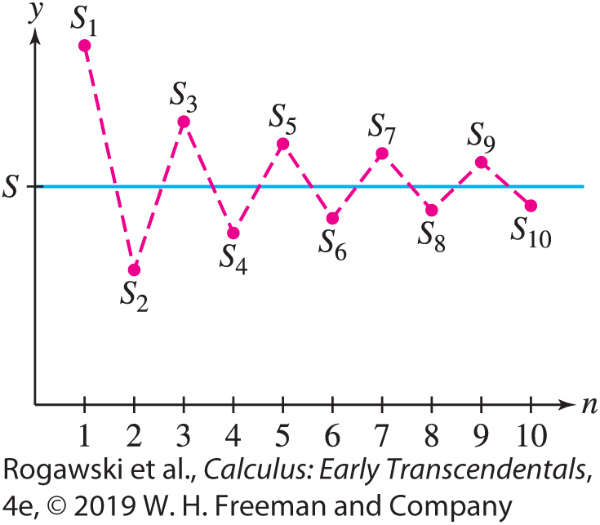
10.4 Absolute and Conditional Convergence (6 of 11)
Proof We will prove that the partial sums zigzag above and below the sum S as in Figure 2. Note first that the even partial sums are increasing. Indeed, the odd-numbered terms occur with a plus sign, and thus S_{2N} + (b_{2N +1} − b_{2N +2}) = S_{2N +2}. But b_{2N +1} − b_{2N +2} > 0 because b_{n} is decreasing, and therefore S_{2N} < S_{2N +2} .
Thus, 0 < S₂ < S₄ < S₆ < ···
Similarly,
S_{2N−1} − (b_{2N} − b_{2N+1}) = S_{2N+1}
and the sequence of odd partial sums is decreasing:
··· < S₇ < S₅ < S₃ < S₁

Slide 80

10.4 Absolute and Conditional Convergence (7 of 11)
Finally, S_{2N} < S_{2N} + b_{2N+1} = S_{2N+1}. The picture is as follows:
0 < S₂ < S₄ < S₆ < ··· < S₇ < S₅ < S₃ < S₁
Now, because bounded monotonic sequences converge (Theorem 6 of Section 10.1), the even and odd partial sums each approach limits that are sandwiched in the middle:
0 < S₂ < S₄ < S₆ < $⋯≤\lim_{N→∞}{S_{2N}}≤\lim_{N→∞}{S_{2N+1}}≤⋯$ < S₇ < S₅ < S₃ < S₁
These two limits must have a common value S because
$$\lim_{N→∞}{S_{2N+1}}−\lim_{N→∞}{S_{2N}}=\lim_{N→∞}{(S_{2N+1}−S_{2N}})=\lim_{N→∞}{b_{2N+1}}=0$$
Therefore, $\lim_{N→∞}{S_{N}}=S,$and the infinite series converges to S. From the inequalities in (1) we also see that 0 < S < S₁ = b₁ and S_{p} < S < S_{q} for all p even and q odd as claimed.

Slide 81
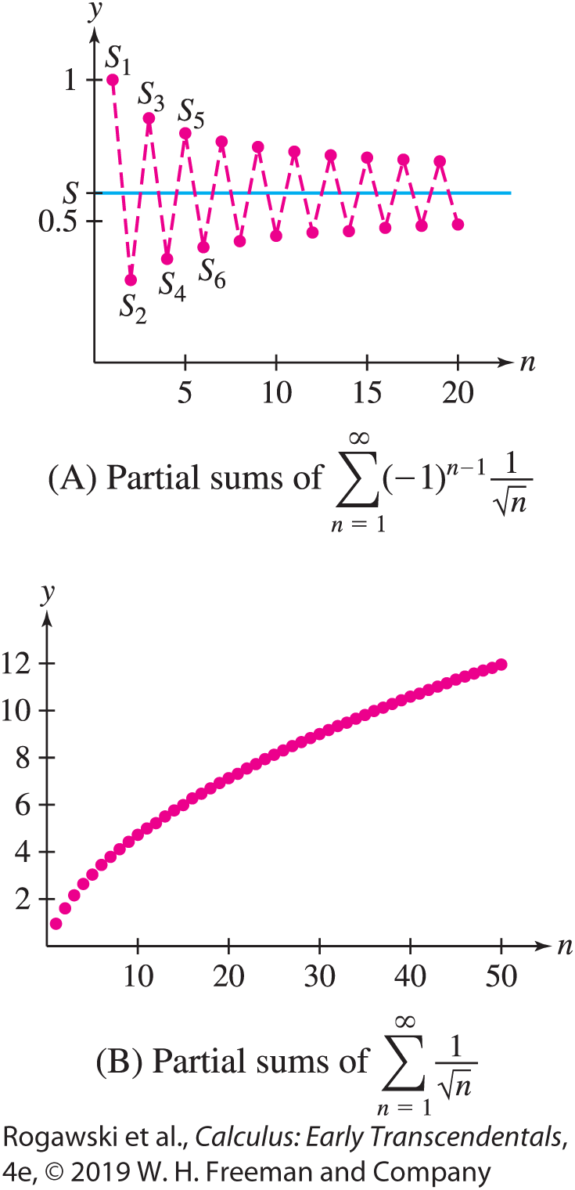


10.4 Absolute and Conditional Convergence (8 of 11)
EX AMPLE: Show that $\sum_{n=1}^{∞}{{(−1)}^{n−1}\frac{1}{\sqrt{n}}}$ converges conditionally.
Furthermore, show that if S is the sum of the series, then 0 ≤ S ≤ 1.
Solution The terms b_{n} = $\frac{1}{\sqrt{n}}$ are positive and decreasing, and $\lim_{n→∞}{b_{n}}=0$. Therefore, the series converges by the Alternating Series Test. Furthermore, if S is the sum of the series, then 0 ≤ S ≤ 1 because b₁ = 1. However, the positive series $\sum_{n=1}^{∞}{\frac{1}{\sqrt{n}}}$ diverges because it is a p-series with p = $\frac{1}{2}$ < 1. Thus, $\sum_{n=1}^{∞}{{(−1)}^{n−1}\frac{1}{\sqrt{n}}}$is conditionally convergent (Figure 3).

Slide 82

10.4 Absolute and Conditional Convergence (9 of 11)
COROLLARY: Let $S=\sum_{n=1}^{∞}{{(−1)}^{n−1}b_{n}}$ where {b_{n}} is a positive decreasing sequence that converges to 0. Then
|S − S_{N}| < b_{N +1}
In other words, when we approximate S by S_{N} , the error is less than the size of the first omitted term b_{N+1}.
Proof If N is even, then N + 1 is odd and the last theorem implies S_{N} < S < S_{N +1}. On the other hand, if N is odd, then N + 1 is even and the same result implies S_{N +1} < S <S_{N} . In either case,
S − S_{N} < S_{N +1} − S_{N} = b_{N +1}

Slide 83

10.4 Absolute and Conditional Convergence (10 of 11)
EXAMPLE: Alternating Harmonic Series Show that $\sum_{n=1}^{∞}{\frac{{(−1)}^{n−1}}{n}}$ converges conditionally. If S represents the sum, then
(a) Show that |S − S₆| < $\frac{1}{7}$ .
(b) Find an N such that S_{N} approximates S with an error less than 10⁻ ³ .
Solution (a) The terms b_{n} = 1/n are positive and decreasing, and $\lim_{n→∞}{b_{n}}$= 0. Therefore, the series converges by the Alternating Series Test. The harmonic series $\sum_{n=1}^{∞}{\frac{1}{n}}$diverges, so the series converges conditionally. Now, applying the inequality in (2), we have
|S − S_{N} | < b_{N +1} = $\frac{1}{n+1}$. For N = 6, we obtain |S − S₆| < b₇ = $\frac{1}{7}$.

Slide 84

10.4 Absolute and Conditional Convergence (11 of 11)
(b) We can make the error less than 10⁻³ by choosing N so that
$$\frac{1}{N+1}≤{10}^{−3} or 1000≤N+1, that is, 999≥N$$
Therefore, with N ≥ 999, S_{N} approximates S with error less than 10⁻³.
For the series in the previous example, a computer algebra system gives S₉₉₉ ≈ 0.6937, and therefore S is within 10⁻³ of this value. In fact, it can be shown that S = ln 2 (see Exercise 92 of Section 10.8). Thus, S = ln 2 ≈ 0.6931, which verifies the result in the example:
|S − S₉₉₉|≈ | ln 2 − 0.6937|≈ 0.0006 < 10⁻³

Slide 85

10.5 The Ratio and Root Tests and Strategies for Choosing Tests (1 of 13)
In the previous sections, we developed a number of theorems and tests that are used to investigate whether a series converges or diverges. In this section, we present two more tests, the Ratio Test and the Root Test. Then we outline a strategy for choosing which test to apply to determine if a specific series converges. We begin with the Ratio Test.
THEOREM: Ratio Test Assume that the following limit exists:
$$ρ=\lim_{n→∞}\left|\frac{a_{n+1}}{a_{n}}\right|$$
If ρ < 1, then $\sum{a_{n}}$ converges absolutely.
If ρ > 1, then $\sum{a_{n}}$ diverges.
If ρ = 1, the test is inconclusive (the series may converge or diverge).

Slide 86

10.5 The Ratio and Root Tests and Strategies for Choosing Tests (2 of 13)
Proof The idea is to compare with a geometric series. If ρ < 1, we may choose a number r such that ρ < r < 1. Since |a_{n+1}/a_{n} | converges to ρ, there exists a number M such that |a_{n+1}/a_{n} | < r for all n ≥ M. Therefore,
|a_{M+1}| < r |a_{M} |, |a_{M+2}| < r |a_{M+1}| < r (r |a_{M} |) = r²|a_{M} |
In general, |a_{M+n} | < r^{n} |a_{M} |. Since r < 1, the geometric series $\sum_{n=0}^{∞}{|a_{M}|r^{n}}$ converges. By the Direct Comparison Test, $\sum_{n=M}^{∞}{a_{n}}$ converges absolutely, and the same holds for $\sum_{n=1}^{∞}{a_{n}}$.
If ρ > 1, choose r such that 1 < r < ρ. Then there exists a number M such that |a_{n+1}/a_{n} | > r for all n ≥ M. Arguing as before with the inequalities reversed, we find that |a_{M+n} |≥ r^{n} | a_{M} |. Since r^{n} tends to ∞, the terms a_{M+n} do not tend to zero, and consequently, $\sum{a_{n}}$diverges.

Slide 87

10.5 The Ratio and Root Tests and Strategies for Choosing Tests (3 of 13)
Finally, we know that $\sum{n^{2}}$ diverges by the nth Term Divergence Test, and that $\sum{\frac{1}{n^{2}}}$ converges.
However,$\lim_{n→∞}{\frac{{(n+1)}^{2}}{n^{2}}}=1$ and $\lim_{n→∞}{\frac{1/{{(n+1)}^{2}}}{1/{n^{2}}}}=\lim_{n→∞}{\frac{n^{2}}{{(n+1)}^{2}}}=1$.
Therefore, both convergence and divergence are possible when ρ = 1, so the test is inconclusive in this case.

Slide 88

10.5 The Ratio and Root Tests and Strategies for Choosing Tests (4 of 13)
EXAMPLE: To show that $\sum_{n=1}^{∞}{\frac{2^{n}}{n!}}$ converges, consider $a_{n}=\frac{2^{n}}{n!}$. Since (n + 1)! = (n + 1)n!,
$$\left|\frac{a_{n + 1}}{a_{n}}\right|=\frac{2^{n+1}}{(n+1)!}\frac{n!}{2^{n}}=\frac{2(n!)}{\left(n+1\right)n!}=\frac{2}{n+2}$$
$$ρ=\lim_{n→∞}\left|\frac{a_{n+1}}{a_{n}}\right|=\lim_{n→∞}{\frac{2}{n+2}}=0<1$$
Therefore, $\sum_{n=1}^{∞}{\frac{2^{n}}{n!}}$ converges absolutely by the Ratio Test.

Slide 89

10.5 The Ratio and Root Tests and Strategies for Choosing Tests (5 of 13)
EXAMPLE: a) To determine if $\sum_{n=1}^{∞}{\frac{n^{2}}{2^{n}}}$ converges, we apply the Ratio Test with $a_{n}=\frac{n^{2}}{2^{n}}:$
$$\left|\frac{a_{n+1}}{a_{n}}\right|=\frac{{(n+1)}^{2}}{2^{n+1}}\frac{2^{n}}{n^{2}}=\frac{1}{2}{\left(\frac{n+1}{n}\right)}^{2}$$
Since $\lim_{n→∞}{\frac{n+1}{n}}=1$, we have $ρ=\lim_{n→∞}\left|\frac{a_{n+1}}{a_{n}}\right|=\frac{1}{2}<1$, and the series converges absolutely by the Ratio Test.
b) The series $\sum_{n=1}^{∞}{{(−1)}^{n−1}\frac{n!}{{1000}^{n}}}$ diverges by the Ratio Test since
$$\left|\frac{a_{n+1}}{a_{n}}\right|=\frac{\left(n+1\right)!}{{1000}^{n+1}}\frac{{1000}^{n}}{n!}=\frac{n+1}{1000}→∞$$
as $n →∞.$ Thus, ρ = ∞ > 1.

Slide 90

10.5 The Ratio and Root Tests and Strategies for Choosing Tests (6 of 13)
Our next test is based on the limit of the nth roots $\sqrt[n]{|a_{n}|}$ rather than the ratios a_{n+1}/a_{n} . Its proof, like that of the Ratio Test, is based on a comparison with a geometric series (see Exercise 63).
THEOREM: Root Test Assume that the following limit exists:
$$L=\lim_{n→∞}{\sqrt[n]{|a_{n}|}}$$
If L < 1, then $\sum{a_{n}}$ converges absolutely.
If L > 1, then $\sum{a_{n}}$ diverges.
If L = 1, the test is inconclusive (the series may converge or diverge).

Slide 91

10.5 The Ratio and Root Tests and Strategies for Choosing Tests (7 of 13)
EXAMPLE: $\sum_{n=1}^{∞}{{\left(\frac{n}{2n + 3}\right)}^{n}}$ converges absolutely by the Root Test since
$$\sqrt[n]{|a_{n}"}=\sqrt[n]{{\left(\frac{n}{2n+3}\right)}^{n}}=\frac{n}{2n+3}→\frac{1}{2}$$
as $n →∞$. Thus, $L=\frac{1}{2}<1$.

Slide 92

10.5 The Ratio and Root Tests and Strategies for Choosing Tests (8 of 13)
Determining Which Test to Apply We end this section with a brief review of all of the tests we have introduced for determining convergence so far and how one decides which test to apply.
Let $\sum_{n=1}^{∞}{a_{n}}$ be given. Keep in mind that the series for which convergence or divergence is known include the geometric series $\sum_{n=0}^{∞}{ar^{n}}$, which converge for | r | < 1, and the p-series $\sum_{n=1}^{∞}{\frac{1}{n^{p}}}$, which converge for p > 1.
1. The nth Term Divergence Test Always check this test first. If $\lim_{n→∞}{a_{n}}≠0$, then the series diverges. But if $\lim_{n→∞}{a_{n}}=0$, we do not know whether the series converges or diverges, and hence we move on to the next step.

Slide 93

10.5 The Ratio and Root Tests and Strategies for Choosing Tests (9 of 13)
Positive Series If all terms in the series are positive, try one of the following tests:
(a) The Direct Comparison Test Consider whether dropping terms in the numerator or denominator gives a series that we know either converges or diverges. If a larger series converges or a smaller series diverges, then the original series does the same.
$$\sum_{n=1}^{∞}{\frac{1}{n^{2}+\sqrt{n}}} converges since\frac{1}{n^{2}+\sqrt{n}}≤\frac{1}{n^{2}} and\sum_{n=1}^{∞}{\frac{1}{n^{2}}} converges.$$

Slide 94

10.5 The Ratio and Root Tests and Strategies for Choosing Tests (10 of 13)
(b) The Limit Comparison Test Consider the dominant term in the numerator and de- nominator, and compare the original series to the ratio of those terms.
$$\sum_{n=2}^{∞}{\frac{1}{n^{2}−\sqrt{n}}} converges since \lim_{n→∞}{\frac{\frac{1}{n^{2}−\sqrt{n}}}{\frac{1}{n^{2}}}}=\lim_{n→∞}{\frac{n^{2}}{n^{2}−\sqrt{n}}}=1 and\sum_{n=1}^{∞}{\frac{1}{n^{2}}} converges.$$

Slide 95

10.5 The Ratio and Root Tests and Strategies for Choosing Tests (11 of 13)
(c) The Ratio Test The Ratio Test is often effective in the presence of a factorial such as n! since in the ratio, the factorial disappears after cancellation. It is also effective when there are constants to the power n, such as 2^{n}, since in the ratio, the power n disappears after cancelation.
$$\sum_{n=1}^{∞}{\frac{3^{n}}{n!}} converges since \frac{{3^{n+1}}/{\left(n+1\right)!}}{{3^{n}}/{n!}}=\frac{3}{n+1}→0<1 as n →∞.$$
(d) The Root Test The Root Test is often effective when there is a term of the form
f (n)^{g(n)}.
$$\sum_{n=1}^{∞}{\frac{2^{n}}{n^{2n}}} converges since \sqrt[n]{\frac{2^{n}}{n^{2n}}}=\frac{2}{n^{2}}→0<1 as n→∞.$$

Slide 96

10.5 The Ratio and Root Tests and Strategies for Choosing Tests (12 of 13)
(d) The Integral Test When the other tests fail on a positive series, consider the Integral Test. If a_{n} = f (n) is a decreasing function, then the series converges if and only if the improper integral $\int_{1}^{∞}{f\left(x\right)dx}$ converges.
$\sum_{n=2}^{∞}{\frac{1}{n\ln{n}}} diverges since \int_{2}^{∞}{\frac{dx}{x\ln{x}}}=\lim_{R→∞}\left(\ln{(\ln{R})}−\ln{(\ln{2})}\right)=∞$.

Slide 97

10.5 The Ratio and Root Tests and Strategies for Choosing Tests (13 of 13)
3. Series That Are Not Positive Series
Alternating Series Test If the series is alternating of the form $\sum_{n=1}^{∞}{{(−1)}^{n−1}}b_{n}$, show that 0 < b_{n+1} < b_{n} and $\lim_{n→∞}{b_{n}}=0$. Then the Alternating Series Test shows the series converges.
(b) Absolute Convergence If the series $\sum{a_{n}}$ is not alternating, then use the tests for positive series to see if $\sum{|a_{n}|}$, which is a positive series, converges. If so, the original series is absolutely convergent and therefore convergent.

Slide 98

10.6 Power Series (1 of 24)
With series we can make sense of the idea of a polynomial of infinite degree:
$$F\left(x\right)=\sum_{n=0}^{∞}{a_{n}x^{n}}=a_{0}+a_{1}x+a_{2}x^{2}+⋯$$
Specifically, a power series with center c is an infinite series
$$F\left(x\right)=\sum_{n=0}^{∞}{a_{n}{(x−c)}^{n}}=a_{0}+a_{1}(x−c)+a_{2}{(x−c)}^{2}+⋯$$
where x is a variable. For example, F (x) = 1 − x + x ² − x ³ + ··· and
G(x) = 1 + (x − 2) + 2(x − 2)² + 3(x − 2)³ + ···
are power series where F (x) has center c = 0 and G(x) has center c = 2.

Slide 99

10.6 Power Series (2 of 24)
A power series $F\left(x\right)=\sum_{n=0}^{∞}{a_{n}{(x−c)}^{n}}$ converges for some values of x and may diverge for others. For example, if we set x = $\frac{9}{4}$ in the power series G(x), we obtain
$$G\left(\frac{9}{4}\right)=1+\sum_{n=1}^{∞}{n{\left(\frac{9}{4}−2\right)}^{n}}=1+\sum_{n=1}^{∞}{n{\left(\frac{1}{4}\right)}^{n}}$$
which converges by the Ratio Test: $\frac{{n+1}/{4^{n+1}}}{n/{4^{n}}}=\frac{1}{4}\frac{n+1}{n}→\frac{1}{4}<1 as n→∞.$
On the other hand, the power series G(x) diverges for x = 3 by the nth Term Divergence Test:
$$G\left(3\right)=1+\sum_{n=1}^{∞}{n{\left(3−2\right)}^{n}}=1+\sum_{n=1}^{∞}{n} diverges.$$

Slide 100
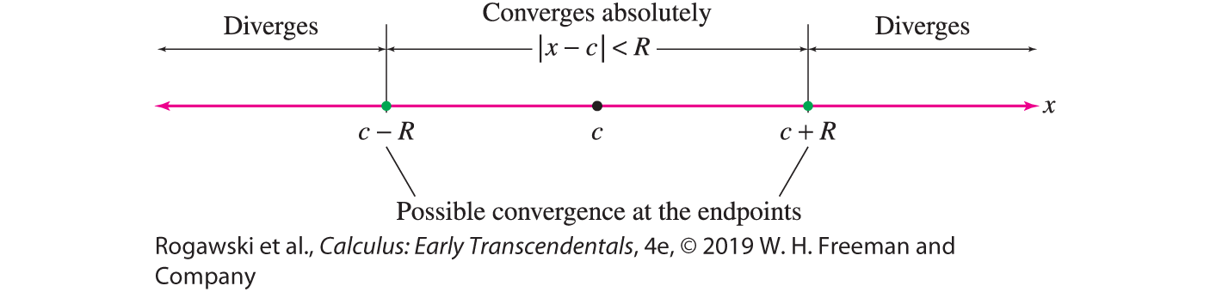
10.6 Power Series (3 of 24)
There is a surprisingly simple way to describe the set of values x at which a power series F(x) converges. According to our next theorem, either F(x) converges absolutely for all values of x, or there is a radius of convergence R such that
F(x ) converges absolutely when |x − c| < R and diverges when |x − c| > R.
This means that F(x) converges for x in an interval of convergence consisting of the open interval (c − R, c + R) and possibly one or both of the endpoints c − R and c + R (Figure 1). Note that F (x) automatically converges at x = c because
F(c) = a₀ + a₁(c − c) + a₂(c − c)² + a₃(c − c)³ + ··· = a₀
R = 0 if F(x) converges only for x = c.
R =∞ if F(x) converges for all values of x .

Slide 101

10.6 Power Series (4 of 24)
THEOREM: Radius of Convergence Every power series
$$F\left(x\right)=\sum_{n=0}^{∞}{a_{n}{(x−c)}^{n}}$$
has a radius of convergence R that is either a nonnegative number (R ≥ 0) or infinity (R = ∞).
If R is finite, F(x) converges absolutely when | x − c| < R and diverges when | x − c| > R.
If R = ∞, then F(x) converges absolutely for all x .

Slide 102

10.6 Power Series (5 of 24)
Proof To simplify our notation, we assume c = 0, and set $r=\lim_{n→∞}\left|\frac{a_{n + 1}}{a_{n}}\right|$. Since F(x) converges at 0, we let x ≠ 0, and consider
$$\lim_{n→∞}\left|\frac{a_{n+1}x^{n+1}}{a_{n}x^{n}}\right|=\lim_{n→∞}\left|\frac{a_{n+1}}{a_{n}}\right|\left|x\right|=r|x|$$
Then $F\left(x\right)$ converges if $r\left|x\right|<1$ and diverges if $r\left|x\right|>1$ by the Ratio Test.
If r = 0, then $r\left|x\right|<1$, and $F(x)$ converges for all real numbers x, and R = ∞.
If r = ∞, then $r\left|x\right|=∞$, and $F(x)$ converges only for x = 0.
If 0 < r < ∞, then $F(x)$ converges if $r\left|x\right|<1, that is, \left|x\right|<\frac{1}{r}$ and diverges $r\left|x\right|>1$, that is, $\left|x\right|>\frac{1}{r}$. Therefore, $R= \frac{1}{r}.$

Slide 103
10.6 Power Series (6 of 24)
From the last theorem, we see that there are two steps in determining the interval of con- vergence of F(x) :
Step 1. Find the radius of convergence R (using the Ratio Test, in most cases).
Step 2. Check convergence at the endpoints (if 0 < R < ∞).

Slide 104
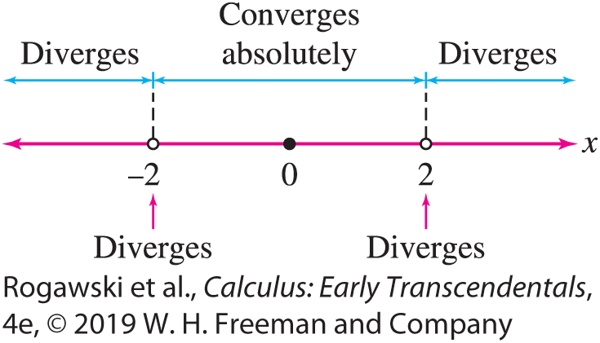

10.6 Power Series (7 of 24)
EXAMPLE: To determine where $\sum_{n=0}^{∞}{\frac{x^{n}}{2^{n}}}$ converges, we let $a_{n}=\frac{x^{n}}{2^{n}}$.
Step 1: Find the Radius of Convergence.
$$\lim_{n→∞}\left|\frac{a_{n+1}}{a_{n}}\right|=\lim_{n→∞}{\frac{{{|x|}^{n+1}}/{2^{n+1}}}{{{|x|}^{n}}/{2^{n}}}=\lim_{n→∞}{\frac{|x|}{2}}=}\frac{|x|}{2}$$
$\frac{|x|}{2}<1 yields \left|x\right|<2 and \frac{|x|}{2}>1 yields \left|x\right|>2$. So the Radius of Convergence is R = 2.
Step 2: Check the endpoints.
$F\left(−2\right)=\sum_{n=0}^{∞}{\frac{{(−2)}^{n}}{2^{n}}}=\sum_{n=0}^{∞}{{(−1)}^{n}}$ and $F\left(2\right)=\sum_{n=0}^{∞}{\frac{2^{n}}{2^{n}}}=\sum_{n=0}^{∞}{1}$
Since both series diverge, F (x) converges only for | x | < 2.

Slide 105
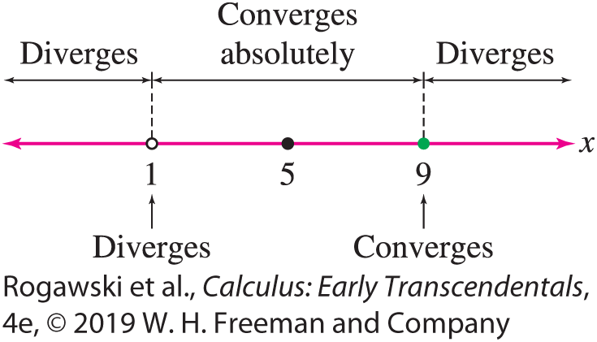

10.6 Power Series (8 of 24)
EXAMPLE: T$o find where F\left(x\right)=\sum_{n=1}^{∞}{\frac{{(−1)}^{n}}{4^{n}n}}{(x−5)}^{n}$ converges, we first compute ρ for $a_{n}=\frac{{(−1)}^{n}}{4^{n}n}{(x−5)}^{n}.$ Since $\left|\frac{a_{n + 1}}{a_{n}}\right|=\frac{{{|x−5|}^{n+1}}/{4^{n+1}(n + 1)}}{{{|x − 5|}^{n}}/{4^{n}n}}=\frac{1}{4}\left|x−5\right|\left(\frac{n}{n+1}\right)→\frac{\left|x − 5\right|}{4} \left(n→∞\right)$,
we have $ρ=\frac{\left|x − 5\right|}{4}$ < 1 exactly if $\left|x−5\right|<4.$ Since the Radius of Convergence is 4, F(x) converges absolutely on the open interval (1, 9). Next, we check the endpoints:
$F\left(1\right)=\sum_{n=1}^{∞}{\frac{{(−1)}^{n}}{4^{n}n}}{(−4)}^{n}=\sum_{n=1}^{∞}{\frac{1}{n}}$ diverges, while$F\left(9\right)=\sum_{n=1}^{∞}{\frac{{(−1)}^{n}}{4^{n}n}}4^{n}=\sum_{n=1}^{∞}{\frac{{(−1)}^{n}}{n}}$ converges. We conclude that F (x ) converges for
x in the half-open interval (1, 9].

Slide 106

10.6 Power Series (9 of 24)
EXAMPLE: T$o find where$ $F\left(x\right)=\sum_{n=0}^{∞}{\frac{x^{2n}}{\left(2n\right)!}}$ converges, we can still apply the Ratio Test with a_{n} = x^{2n} /(2n)! although the series has only even powers of x . We have $a_{n+1}=\frac{x^{2n+2}}{\left(2n + 2\right)!}$. Furthermore, (2n + 2)! = (2n + 2)(2n + 1)(2n)!, so
$$\left|\frac{a_{n+1}}{a_{n}}\right|=\frac{{{|x|}^{2n+2}}/{\left(2n+2\right)!}}{{{|x|}^{2n}}/{\left(2n\right)!}}=x^{2}\frac{1}{(2n+2)(2n+1)}→0 (n→∞)$$
Thus, $ρ=0,$ and the power series has an infinite radius of convergence. It converges for all real numbers x.

Slide 107

10.6 Power Series (10 of 24)
Geometric series are important examples of power series. Recall the formula
$$\sum_{n=0}^{∞}{r^{n}}=\frac{1}{1−r}$$
valid for | r | < 1. Writing x in place of r, we obtain a power series expansion with radius of convergence R = 1:
$$\sum_{n=0}^{∞}{x^{n}}=\frac{1}{1−x} (2)$$
The next two examples show that we can modify this formula to find the power series expansions of other functions.

Slide 108

10.6 Power Series (11 of 24)
EXAMPLE: a) To find a power series expansion for $f\left(x\right)=\frac{1}{1 − 2x},$ we substitute 2x for x in (2):
$$f\left(x\right)=\frac{1}{1−(2x)}=\sum_{n=0}^{∞}{{(2x)}^{n}}=\sum_{n=0}^{∞}{2^{n}x^{n}}$$
which is valid for $\left|2x\right|<1,$ or $\left|x\right|<\frac{1}{2}.$
b) For a power series expansion for $f\left(x\right)=\frac{1}{2 + x^{2}}$, observe that $\frac{1}{2 + x^{2}}=\left(\frac{1}{2}\right)\left(\frac{1}{1 − (−{x^{2}}/2)}\right).$ So,
$$f\left(x\right)=\left(\frac{1}{2}\right)\left(\frac{1}{1 −(−{x^{2}}/2)}\right)=\frac{1}{2}\sum_{n=0}^{∞}{{(−1)}^{n}}\frac{x^{2n}}{2^{n}}=\sum_{n=0}^{∞}{{(−1)}^{n}}\frac{x^{2n}}{2^{n+1}}$$
The expansion is valid if |−x ²/2| < 1, $\left|x\right|< \sqrt{2}.$ The interval of convergence is $\left(−\sqrt{2},\sqrt{2}\right).$

Slide 109

10.6 Power Series (12 of 24)
THEOREM: Term-by-Term Differentiation and Integration Assume that
$$F\left(x\right)=\sum_{n=0}^{∞}{a_{n}{(x−c)}^{n}}$$
has radius of convergence R > 0. Then F is differentiable on (c − R, c + R). Furthermore, we can integrate and differentiate term by term. For x ∈ (c − R, c + R),
$$F^{′}(x)=\sum_{n=1}^{∞}{{na}_{n}{\left(x−c\right)}^{n−1}}$$
$$\int{F\left(x\right)dx}=A+\sum_{n=0}^{∞}{\frac{a_{n}}{n+1}{(x−c)}^{n+1}} (\text{A} \text{an}\text{y} \text{constan}\text{t}\text{)}$$
For both the derivative series and the integral series, the radius of convergence is R too.

Slide 110

10.6 Power Series (13 of 24)
EX AMPLE: Differentiating a Power Series Prove that for −1 < x < 1,
$$\frac{1}{{(1−x)}^{2}}=\sum_{n=0}^{∞}{(n+1)x^{n}}$$
Solution
$$\frac{1}{{(1−x)}^{2}}=\frac{d}{dx}\left(\frac{1}{1−x}\right)=\frac{d}{dx}\left(\sum_{n=0}^{∞}{x^{n}}\right)=\sum_{n=1}^{∞}{nx^{n−1}}=\sum_{n=0}^{∞}{(n+1)x^{n}}$$

Slide 111

10.6 Power Series (14 of 24)
EXAMPLE: The function $y=\tan^{−1}{x}$ is an antiderivative of $y=\frac{1}{1 + x^{2}}$. In view of
$$\frac{1}{1+x^{2}}=\frac{1}{1−(−x^{2})}=\sum_{n=0}^{∞}{{(−1)}^{n}x^{2n}}$$
we have
$$\tan^{−1}{x}=\int{\frac{1}{1+x^{2}}}dx=A+\sum_{n=0}^{∞}{\frac{{(−1)}^{n}}{2n+1}x^{2n+1}}$$
Since $0= \tan^{−1}{0}=A+\sum_{n=0}^{∞}{\frac{{(−1)}^{n}}{2n+1}0^{2n+1}}=A,$ we obtain for $−1<x<x:$
$$\tan^{−1}{x}=\sum_{n=0}^{∞}{\frac{{(−1)}^{n}}{2n+1}x^{2n+1}}$$

Slide 112

10.6 Power Series (15 of 24)
Power series are a basic tool in the study of differential equations. To illustrate this, we consider the differential equation $y^{′}=y$with initial condition $y\left(0\right)=1.$ From Section 9.1, it follows that f (x) = e^{x} is a solution to this Initial Value Problem.
Here, we take a different approach and try to find a solution in form of a power series $F\left(x\right)=\sum_{n=0}^{∞}{a_{n}x^{n}}$. Ultimately, this approach will provide us with a power series representation of f (x) = e^{x} . We have
$$F\left(x\right)=\sum_{n=0}^{∞}{a_{n}x^{n}} and F^{′}\left(x\right)=\sum_{n=0}^{∞}{na_{n}x^{n−1}}$$
To satisfy the differential equation, we must have $F^{′}\left(x\right)=F(x)$, and therefore
a₀ = a₁, a₁ = 2a₂, a₂ = 3a₃, a₃ = 4a₄, ... , a_{n−1} = na_{n ,}···

Slide 113

10.6 Power Series (16 of 24)
Therefore, we get the recursive relation $a_{n}=\frac{a_{n−1}}{n}.$ It enables us to determine all of the coefficients a_{n} successively from the first coefficient a₀, which may be chosen arbitrarily. For example,
n = 1: $a_{1}=\frac{a_{0}}{1}$
n = 2: $a_{2}=\frac{a_{1}}{2}=\frac{a_{0}}{2 ∙ 1}=\frac{a_{0}}{2!}$
n = 3: $a_{3}=\frac{a_{2}}{3}=\frac{a_{0}}{3 ∙ 2 ∙ 1}=\frac{a_{0}}{3!}$
To obtain a general formula for a_{n} , apply the recursion relation n times:
$$a_{n}=\frac{a_{n−1}}{n}=\frac{a_{n−2}}{n(n−1)}=\frac{a_{n−3}}{n(n−1)(n−2)}=\frac{a_{0}}{n!}$$

Slide 114

10.6 Power Series (17 of 24)
We conclude that
$$F\left(x\right)=a_{0}\sum_{n=0}^{∞}{\frac{x^{n}}{n!}}$$
Hence, the initial condition gives
$$1=F\left(0\right)=a_{0}\sum_{n=0}^{∞}{\frac{0^{n}}{n!}}=a_{0}$$
Therefore,
$$F\left(x\right)=\sum_{n=0}^{∞}{\frac{x^{n}}{n!}}$$

Slide 115

10.6 Power Series (18 of 24)
In Section 9.1, we showed that f (x) = $e^{x}$ is not just a solution to the Initial Value Problem; rather, it is the only solution. The uniqueness of the solution implies that $e^{x}$ and the power series solution we obtained must be equal. Thus, we have found a power series representation for $e^{x}$ that is valid for all x:
$$e^{x}=\sum_{n=0}^{∞}{\frac{x^{n}}{n!}}$$
In Section 10.8, we will see how to arrive at this power series representation of $e^{x}$ via what are known as Taylor series.

Slide 116

10.6 Power Series (19 of 24)
In contrast to $y^{′}=y$, the differential equation in the next example cannot be solved using any method that is simpler than the process of finding a power series solution. As with the solution of $y^{′}=y$, the process involves solving a recursion relation that determines the coefficients a_{n} of a power series for the solution.
EX AMPLE: Find a power series solution to the Initial Value Problem:
$$x^{2}y^{′′}+xy^{′}+\left(x^{2}−1\right)y=0, y^{′}\left(0\right)=1$$

Slide 117

10.6 Power Series (20 of 24)
Solution We assume that the initial value problem has a solution of the form
$$F\left(x\right)=\sum_{n=0}^{∞}{a_{n}x^{n}}$$
and compute the derivatives:
$$F^{′\left(x\right)}=\sum_{n=0}^{∞}{na_{n}x^{n−1}}$$
$$F′′\left(x\right)=\sum_{n=0}^{∞}{n(n−1)a_{n}x^{n−2}}$$

Slide 118

10.6 Power Series (21 of 24)
Now, substitute the series for y, $y′$, and $y′′$ into the differential equation to determine the recursion relation satisfied by the coefficients a_{n}:
$$0=x^{2}y^{′′}+xy^{′}+\left(x^{2}−1\right)y=$$
$$x^{2}\sum_{n=0}^{∞}{n(n−1)a_{n}x^{n−2}}+x\sum_{n=0}^{∞}{na_{n}x^{n−1}}+(x^{2}−1)\sum_{n=0}^{∞}{a_{n}x^{n}}$$
$$=\sum_{n=0}^{∞}{n(n−1)a_{n}x^{n}}+\sum_{n=0}^{∞}{na_{n}x^{n}}−\sum_{n=0}^{∞}{a_{n}x^{n}}+\sum_{n=0}^{∞}{a_{n}x^{n+2}}$$
$$=\sum_{n=0}^{∞}{(n^{2}−1)a_{n}x^{n}}+\sum_{n=2}^{∞}{a_{n−2}x^{n}}$$

Slide 119

10.6 Power Series (22 of 24)
The differential equation is satisfied if
$$\sum_{n=0}^{∞}{(n^{2}−1)a_{n}x^{n}}=−\sum_{n=2}^{∞}{a_{n−2}x^{n}}$$
Matching up the coefficients of x^{n} , we find that
−a₀ = 0, 3a₂ = −a₀, 8a₃ = −a₁, 15a₄ = −a₂, ... (8)
In general, (n² − 1)a_{n} = −a_{𝑛 − 2}, which yields the recursion relation
$$a_{n}=−\frac{a_{n−2}}{n^{2}−1} \left(n≥2\right) (9)$$

Slide 120

10.6 Power Series (23 of 24)
Note that a₀ = 0 by Eq. (8). The recursion relation forces all of the even coefficients a_{2n} to be zero: $a_{2}=−\frac{a_{0}}{4 − 1}=0,$ $a_{4}=−\frac{a_{2}}{16 − 1}=0,$ and so on.
As for the odd coefficients, a₁ may be chosen arbitrarily. Because $F^{′}\left(0\right)=a_{1}$, we set
a₁ = 1 to obtain a solution y = F (x) satisfying $F′(0)$ = 1.
Every odd number n can be written as n = 2k + 1. Therefore,
n² − 1 = (2k + 1)² − 1 = 4k² + 4k = 4k(k + 1)
This allows us to rewrite Eq. (9) in terms of k as
$$a_{2k+1}=−\frac{a_{2k−1}}{4k\left(k+1\right)}$$

Slide 121

10.6 Power Series (24 of 24)
Applying this recursion relation k times, we obtain the closed formula
$$a_{2k+1}={(−1)}^{k}\frac{1}{4k\left(k+1\right)4k}\frac{1}{(k−1)}⋯\frac{1}{4∙1∙2}={(−1)}^{k}\frac{1}{4^{k}k!\left(k+1\right)!}$$
Thus, we obtain a power series representation of our solution:
$$F\left(x\right)=\sum_{k=0}^{∞}{{(−1)}^{k}\frac{1}{4^{k}k!\left(k+1\right)!}x^{2k+1}}$$
A straightforward application of the Ratio Test shows that F has an infinite radius of convergence. Therefore, F (x) is a solution of the Initial Value Problem for all real numbers x .

Slide 122
10.7 Taylor Polynomials (1 of 26)
Using power series, we have seen how we can express some functions as polynomials of infinite degree. We saw that we can take power series for specific functions and manipulate them by substitution, differentiation, integration, and algebraic operations to obtain power series for other functions.
Next, we consider how we can obtain a power series for a function. To do so, first we introduce Taylor polynomials, special polynomial functions that turn out to be partial sums of the power series of a function. The Taylor polynomials are important in their own right since they are useful tools for approximating functions. In the next section, we extend these Taylor polynomials to Taylor series representations of functions.

Slide 123

10.7 Taylor Polynomials (2 of 26)
Many functions are difficult to work with. For instance, f (x) = sin(x ²) or $f\left(x\right)=e^{x^{2}}$ cannot be integrated using elementary functions. In fact, even many simple functions like f (x) = sin x, f (x) = cos x, f (x) = e^{x}, and f (x) = ln x can be evaluated exactly at only a relatively few values of x, and otherwise they must be numerically approximated. On the other hand, polynomials such as f (x) = 3x ⁴ − 7x ³ + 2x − 4 can be easily differentiated and integrated. They can be evaluated at any value of x using just multiplication and addition. Thus, given a function, it is natural to ask if there is a way to accurately approximate the function using a polynomial function.
We have worked with a simple polynomial approximation of a function before. In Section 4.1, we used the linearization L(x) = f (a) + $f′$(a)(x − a) to approximate f (x) near a point x = a:
f (x ) ≈ f (a) + $f′$(a)(x − a)

Slide 124
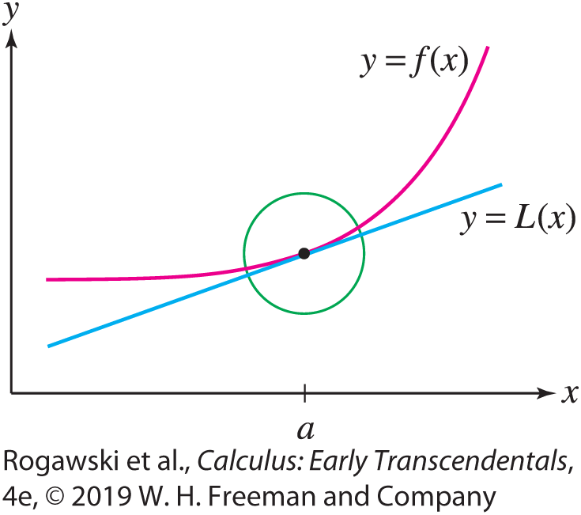
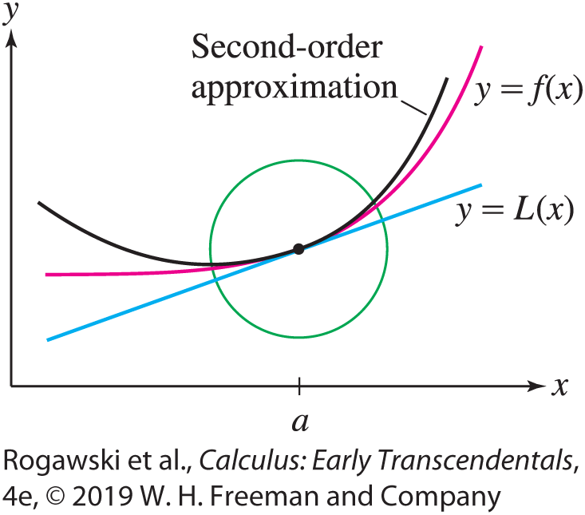

10.7 Taylor Polynomials (3 of 26)
We refer to L(x) as a “first-order” approximation to f (x) at x = a because f (x) and L(x) have the same value and the same first derivative at x = a (Figure 1):
L(a) = f (a), $L′$(a) = $f′$(a)
A first-order approximation is useful only in a small interval around x = a. In this section, we achieve greater accuracy over larger intervals using higher-order approximations (Figure 2). These higher-order approximations will simply be polynomials with higher powers, the Taylor polynomials. Along with using Taylor polynomials to approximate functions, we will develop tools for estimating the error in the approximation.

Slide 125

10.7 Taylor Polynomials (4 of 26)
In what follows, assume that f is defined on an open interval I and that all higher derivatives
f ^{(k)} exist on I. Let a ∈ I. We say that two functions f and g agree to order n at x = a if their derivatives up to order n at x = a are equal:
$$f\left(a\right)=g\left(a\right), f^{′}\left(a\right)=g^{′}\left(a\right), f^{′′}\left(a\right)=g^{′′}\left(a\right), …,f^{\left(n\right)}\left(a\right)=g^{\left(n\right)}(a)$$
We also say that g approximates f to order n at x = a.
Define the nth Taylor polynomial T_{n} of f centered at x = a as follows:
$$T_{n}\left(x\right)=f\left(a\right)+\frac{f^{′}\left(a\right)}{1!}\left(x−a\right)+\frac{f′′(a)}{2!}{(x−a)}^{2}+⋯+\frac{f^{n}(a)}{n!}{(x−a)}^{n}$$

Slide 126

10.7 Taylor Polynomials (5 of 26)
The first few Taylor polynomials are
T₀(x) = f (a)
T₁(x) = f (a) + $f′$(a)(x − a)
T₂(x) = f (a) + $f′$(a)(x − a) + $\frac{1}{2}f′′$(a)(x − a)²
T₃(x) = f (a) + $f′$(a)(x − a) + $\frac{1}{2}f′′$(a)(x − a)² + $\frac{1}{6}f′′′$(a)(x − a)³
Note that T₁ is the linearization of f at a. Note also that T_{n} is obtained from T_{n−1} by adding on a term of degree n:
$$T_{n}\left(x\right)=T_{n−1}\left(x\right)+\frac{f^{\left(n\right)}\left(a\right)}{n!}{(x−a)}^{n}$$

Slide 127

10.7 Taylor Polynomials (6 of 26)
THEOREM: The polynomial T_{n} centered at a agrees with f to order n at x = a, and it is the only polynomial of degree at most n with this property.
The verification of this theorem is left to the exercises (Exercises 76–77), but we illustrate the idea by checking that T₂ agrees with f to order n = 2:
T₂(x) = f (a) + $f′$(a)(x − a) + $\frac{1}{2}f′′$(a)(x − a)² $T_{2}\left(a\right)=f(a)$
$T_{2}^{′}$(x) = $f′$(a) + $f′′$(a)(x − a) $T_{2}^{′}$(a) = $f′(a)$
$T_{2}^{′′}$(x) = $f′′$(a) $T_{2}^{′′}$(x) = $f′′$(a)

Slide 128

10.7 Taylor Polynomials (7 of 26)
Before proceeding to the examples, we write T_{n} in summation notation:
$$T_{n}\left(x\right)=\sum_{j=0}^{n}{\frac{f^{\left(j\right)}(a)}{j!}{(x−a)}^{j}}$$
By convention, we regard f as the zeroth derivative, and thus f ⁽⁰⁾ is f itself. When
a = 0, T_{n} is also called the nth Maclaurin polynomial.
EXAMPLE: Maclaurin Polynomials for f (x ) = e^{x}
Plot the third and fourth Maclaurin polynomials for f (x) = e^{x}.
Compare with the linear approximation.

Slide 129
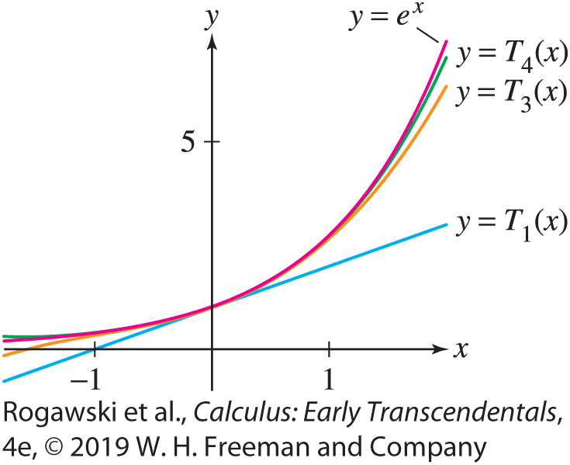

10.7 Taylor Polynomials (8 of 26)
Solution All higher derivatives coincide with f itself: f ^{(k)}(x ) = e^{x} . Therefore,
f (0) = $f′$(0) = $f′′$(0) = $f′′′$(0) = f ⁽⁴⁾(0) = e⁰ = 1
The third Maclaurin polynomial (the case a = 0) is
T₃(x) = f (0) + $f′$(0)x + $\frac{1}{2}f′′$(0)x + $\frac{1}{3!}f′′′$(0)x = 1 + x + $\frac{1}{2}$ x² + $\frac{1}{6}$ x³
We obtain T₄(x ) by adding the term of degree 4 to T₃(x ):
$$T_{4}\left(x\right)=T_{3}\left(x\right)+\frac{f^{\left(4\right)}(0)}{4!}=\text{1} \text{+} \text{x} \text{+} \frac{1}{2} \text{x}\text{2} \text{+} \frac{1}{6} \text{x}\text{3} \text{+ }\frac{1}{24}x^{4}$$
Figure 3 shows that T₃ and T₄ approximate f (x ) = e^{x} much more closely than the linear approximation T₁ on an interval around a = 0.

Slide 130

10.7 Taylor Polynomials (9 of 26)
EX AMPLE: For objects near the surface of the earth, to two decimal places, the acceleration due to gravity is g = 9.81 m/s². For objects at higher altitudes, Newton’s Law of Gravitation says that the acceleration due to gravity is
$$G\left(h\right)=\frac{g}{{\left(1+\frac{h}{6370}\right)}^{2}}$$
where G(h) is in m/s², h is the altitude above the surface of the earth in km, and 6370 is the radius of the Earth in km.
Find a power series representation of G as a function of h. For what values of h is the power series valid?
Use the third Maclaurin polynomial to approximate the acceleration due to gravity on an object at an altitude of 1000 km, and estimate the error in the approximation.

Slide 131

10.7 Taylor Polynomials (10 of 26)
Solution
(a) We use the power series representation for $\frac{1}{{(1 − x)}^{2}}$ from the previous section.
$$G\left(h\right)=\sum_{n=0}^{∞}{g\frac{(n+1){(−h)}^{n}}{{6370}^{n}}}$$
The power series for $\frac{1}{{(1 − x)}^{2}}$ is valid for −1 < x < 1, and therefore the series for G(h)
holds for −1 < $−\frac{h}{6370}$< 1. Since altitude is nonnegative, it follows that the power series
for G(h) is valid for 0 ≤ h < 6370.

Slide 132

10.7 Taylor Polynomials (11 of 26)
Using the third Maclaurin polynomial,
$$G\left(1000\right)=9.81−\frac{19.6∙1000}{6370}+\frac{29.4{\left(1000\right)}^{2}}{{6370}^{2}}+\frac{39.2{\left(1000\right)}^{3}}{{6370}^{3}}≈7.30\frac{m}{s^{2}}$$
Since we have an alternating series, we can apply the corollary in Section 10.4 and use the fourth power term in the series to estimate the error in our approximation. Thus,
$$error<\frac{49.0{(1000)}^{4}}{{6370}^{4}}≈0.03$$

Slide 133

10.7 Taylor Polynomials (12 of 26)
EXAMPLE: Computing Taylor Polynomials We compute the Taylor polynomial T₄ centered at a = 3 for $f\left(x\right)=\sqrt{x+1}:$
$$f\left(x\right)={(x+1)}^{1/2}, f\left(3\right)=2$$
$$f^{′}(x)={\frac{1}{2}\left(x+1\right)}^{−1/2}, f^{′}\left(3\right)=\frac{1}{4}$$
$$f^{′′}\left(x\right)={−\frac{1}{4}\left(x+1\right)}^{−3/2}, f^{′′}\left(3\right)=−\frac{1}{32}, \frac{f^{′′}\left(3\right)}{2!}=−\frac{1}{64}$$
$$f^{′′′}\left(x\right)={\frac{3}{8}\left(x+1\right)}^{−5/2}, f^{′′′}\left(3\right)=\frac{3}{256}, \frac{f′′′(3)}{3!}=\frac{1}{512}$$
$$f^{(4)}\left(x\right)={−\frac{15}{16}(x+1)}^{−7/2}, f^{\left(4\right)}\left(3\right)=−\frac{15}{2048}, \frac{f^{\left(4\right)}\left(3\right)}{4!}=−\frac{5}{16,384}$$

Slide 134
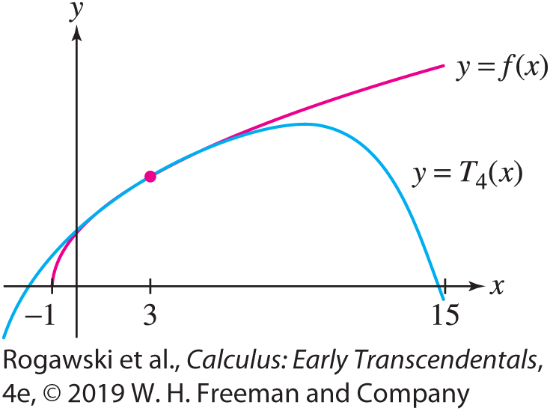

10.7 Taylor Polynomials (13 of 26)
The Taylor polynomial T₄ centered at a = 3 is (see Figure 4)
$$T_{4}\left(x\right)=2+\frac{1}{4}\left(x−3\right)−\frac{1}{64}{\left(x−3\right)}^{2}+\frac{1}{512}{\left(x−3\right)}^{3}−\frac{5}{16384}{(x−3)}^{4}$$

Slide 135

10.7 Taylor Polynomials (14 of 26)
EX AMPLE: Finding a General Formula for T_{n} Find the Taylor polynomials T_{n} of
f (x) = ln x centered at a = 1.
Solution For f (x) = ln x, the constant term of T_{n} at a = 1 is zero because f (1) = ln 1 = 0. Next, we compute the derivatives:
$f′$(x) = x ⁻¹, $f′′$(x) = −x ⁻², $f′′′$(x) = 2x ⁻³, $f^{(4)}$(x) = −3 · 2x ⁻⁴, f ⁽⁵⁾(x ) = 4 · 3 · 2x ⁻⁵
The general pattern is that f ^{(k)}(x ) is a multiple of x ^{−k} , with a coefficient ±(k − 1)! that alternates in sign:
f ^{(k)}(x ) = (−1)^{k−1}(k − 1)! x ^{−k}

Slide 136

10.7 Taylor Polynomials (15 of 26)
The coefficient of (x − 1)^{k} in T_{n} is
$$\frac{f^{\left(k\right)}(1)}{k!}=\frac{{\left(−1\right)}^{k}\left(k−1\right)!}{k!}=\frac{{\left(−1\right)}^{k}}{k}$$
Thus,
$$T_{n}\left(x\right)=\left(x−1\right)−\frac{1}{2}{\left(x−1\right)}^{2}+\frac{1}{3}{\left(x−1\right)}^{3}−⋯+{\left(−1\right)}^{n}\frac{1}{n}{\left(x−1\right)}^{n}$$

Slide 137

10.7 Taylor Polynomials (16 of 26)
EXAMPLE: Cosine Find the Maclaurin polynomials of f (x) = cos x .
Solution The derivatives form a repeating pattern of period 4:
f (x) = cos x, $f′$(x) = − sin x, $f′′$(x) = − cos x,
$f′′′$(x) = sin x, f ⁽⁴⁾(x) = cos x, f ⁽⁵⁾(x) = − sin x, ···
In general, f ^{( j +4)}(x) = f ^{( j )}(x). The derivatives at x = 0 also form a pattern:
Therefore, the coefficients of the odd powers x^{2k+1} are zero, and the coefficients of the even powers x^{2k} of the Maclaurin polynomial alternate in sign with value (−1)^{k} /(2k)!:
$$f(0)$$ | $$f′(0)$$ | $$f′′(0)$$ | $$f′′′(0)$$ | $$f^{\left(4\right)}(0)$$ | $$f^{\left(5\right)}(0)$$ | $$f^{\left(6\right)}(0)$$ | $$f^{\left(7\right)}(0)$$
$$1$$ | $$0$$ | $$−1$$ | $$0$$ | $$1$$ | $$0$$ | $$−1$$ | $$0$$

Slide 138
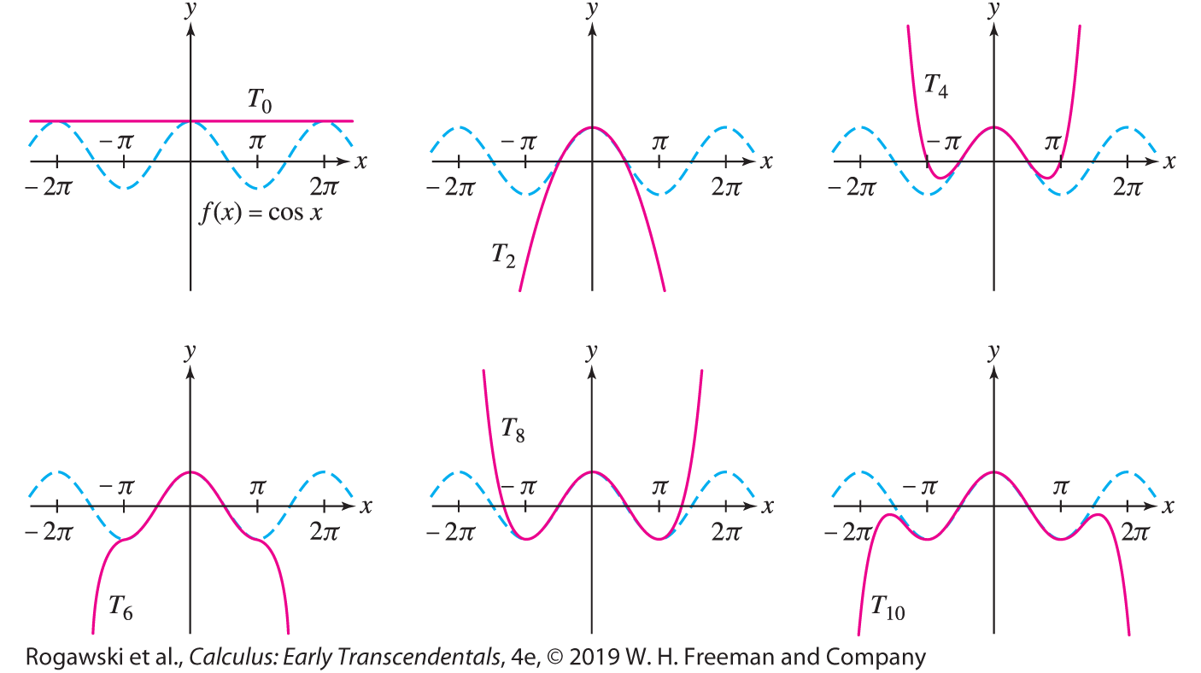

10.7 Taylor Polynomials (17 of 26)
$$T_{0}\left(x\right)=T_{1}\left(x\right)=1, T_{2}\left(x\right)=T_{3}\left(x\right)=1−\frac{1}{2}x^{2}, T_{4}\left(x\right)=T_{5}\left(x\right)=1−\frac{1}{2}x^{2}+\frac{1}{4!}x^{4}$$
$$T_{2n}\left(x\right)=T_{2n+1}\left(x\right)=1−\frac{1}{2}x^{2}+\frac{1}{4!}x^{4}−\frac{1}{6!}x^{6}+⋯+{(−1)}^{n}\frac{1}{\left(2n\right)!}x^{2n}$$
Figure 5 shows that as n increases, T_{n} approximates f (x) = cos x well over larger and larger intervals, but outside this interval, the approximation fails.

Slide 139

10.7 Taylor Polynomials (18 of 26)
To use Taylor polynomials effectively to approximate a function, we need a way to estimate the size of the error in the approximation. This is provided by the next theorem, which shows that the size of this error depends on the size of the (n + 1)st derivative.
THEOREM: Error Bound Assume that f ^{(n+1)} exists and is continuous. Let K be a number such that | f ^{(n+1)}(u)| ≤ K for all u between a and x . Then
$$|f\left(x\right)−T_{n}\left(x\right)|≤K\frac{{|x−a|}^{n+1}}{\left(n+1\right)!}$$
where T_{n} is the nth Taylor polynomial centered at x = a.

Slide 140

10.7 Taylor Polynomials (19 of 26)
EXAMPLE: Using the Error Bound Apply the Error Bound to | ln 1.2 − T₃(1.2)|,
where T₃ is the third Taylor polynomial for f (x ) = ln x at a = 1. Check your result with a calculator.
Solution Step 1. Find a value of K.
To use the Error Bound with n = 3, we must find a value of K such that | f ⁽⁴⁾(u)| ≤ K for all u between a = 1 and x = 1.2. As we computed in a previous example, f ⁽⁴⁾(x) = −6x⁻⁴. The absolute value | f ⁽⁴⁾(x )| is decreasing for x > 0, so its maximum value on [1, 1.2] is | f ⁽⁴⁾(1)|= 6. Therefore, we may take K = 6.
Step 2. Apply the Error Bound.
$$\left|\ln{1.2}−T_{3}\left(1.2\right)\right|≤K\frac{{\left|x−a\right|}^{n+1}}{\left(n+1\right)!}=6\frac{{(1.2−1)}^{4}}{4!}≈\text{0.0004}$$

Slide 141
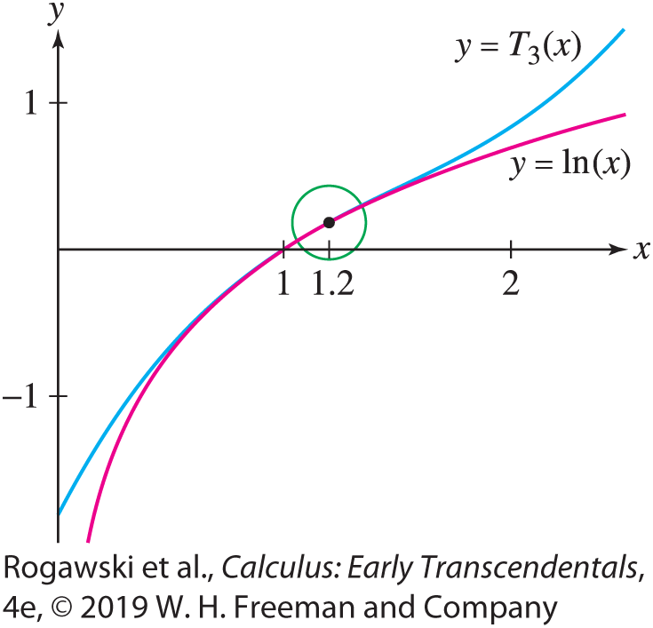

10.7 Taylor Polynomials (20 of 26)
Step 3. Check the result.
Recall from a previous example that
$$T_{n}\left(x\right)=\left(x−1\right)−\frac{1}{2}{\left(x−1\right)}^{2}+\frac{1}{3}{\left(x−1\right)}^{3}$$
The following values from a calculator confirm that the error is at most 0.0004:
|ln 1.2 − T₃(1.2)|≈ |0.182667 − 0.182322|≈ 0.00035 < 0.0004
Observe in Figure 6 that y = ln x and y = T₃(x) are indistinguishable near x = 1.2.

Slide 142

10.7 Taylor Polynomials (21 of 26)
EX AMPLE: Approximating with a Given Accuracy Let T_{n} be the nth Maclaurin polynomial for f (x ) = cos x . Find a value of n such that
| cos 0.2 − T_{n} (0.2)| < 10⁻⁵
Solution
Step 1. Find a value of K .
Since | f ^{(n)}(x )| is | cos x | or | sin x |, depending on whether n is even or odd, we have | f ^{(n)}(u)| ≤ 1 for all u. Thus, we may apply the Error Bound with K = 1.
Step 2. Find a value of n.
The Error Bound gives us $\left|\cos{0.2}−T_{n}\left(0.2\right)\right|≤K\frac{{\left(0.2 − 0\right)}^{n+1}}{\left(n + 1\right)!}=\frac{1}{5^{n+1}\left(n + 1\right)!}.$

Slide 143
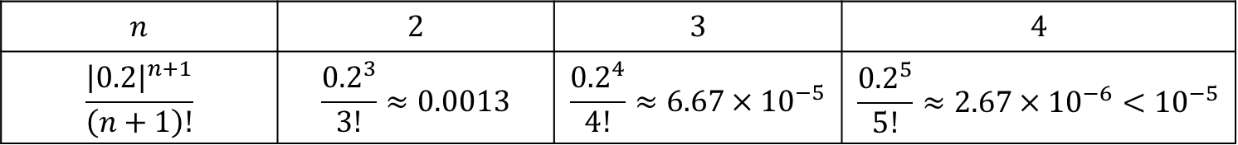

10.7 Taylor Polynomials (22 of 26)
To make the error less than 10⁻⁵, we must choose n so that
$$\frac{1}{5^{n+1}\left(n+1\right)!}<{10}^{−5}$$
It’s not possible to solve this inequality for n, but we can find a suitable n by checking several values:
We see that the error is less than 10⁻⁵ for n = 4.
$$n$$ | $$2$$ | $$3$$ | $$4$$
$$\frac{{\left|0.2\right|}^{n+1}}{\left(n+1\right)!}$$ | $$\frac{{0.2}^{3}}{3!}≈0.0013$$ | $$\frac{{0.2}^{4}}{4!}≈6.67×{10}^{−5}$$ | $$\frac{{0.2}^{5}}{5!}≈2.67×{10}^{−6}<{10}^{−5}$$

Slide 144

10.7 Taylor Polynomials (23 of 26)
The rest of this section is devoted to a proof of the Error Bound (Theorem 2). Define the nth remainder:
R_{n} (x) = f (x) − T_{n} (x)
The error in T_{n} (x) is the absolute value |R_{n} (x)|. As a first step in proving the Error Bound, we show that R_{n} (x) can be represented as an integral.
Taylor’s Theorem: Assume that f ^{(n+1)} exists and is continuous. Then
$$R_{n}\left(x\right)=\frac{1}{n!}\int_{a}^{x}{{\left(x−u\right)}^{n}f^{\left(n+1\right)}\left(u\right)du}$$

Slide 145

10.7 Taylor Polynomials (24 of 26)
Proof Set
$$I_{n}\left(x\right)=\frac{1}{n!}\int_{a}^{x}{{\left(x−u\right)}^{n}f^{\left(n+1\right)}\left(u\right)du}$$
Our goal is to show by induction on n that R_{n} (x) = I_{n} (x). For n = 0, R₀(x) = f (x) − f (a) and the desired result is just a restatement of the Fundamental Theorem of Calculus:
$$I_{0}\left(x\right)=\int_{a}^{x}{f^{′}\left(x\right)dx=}f\left(x\right)−f\left(a\right)=R_{0}\left(x\right)$$
To prove the formula for n > 0, we apply Integration by Parts to I_{n} (x ) with
$$h\left(u\right)=\frac{1}{n!}{(x−u)}^{n} and g\left(u\right)=f^{\left(n\right)}\left(u\right)$$
Then $h′(x)=−\frac{1}{(n − 1)!}{(x−u)}^{n−1}$ and $g′\left(u\right)=f^{\left(n+1\right)}\left(u\right)$.

Slide 146

10.7 Taylor Polynomials (25 of 26)
$$I_{n}\left(x\right)=\int_{a}^{x}{h\left(u\right)g′(u) du}=h\left(u\right)g\left(u\right)|_{a}^{x}−\int_{a}^{x}{h^{′}\left(u\right)g\left(u\right)du}$$
$$=\frac{1}{n!}{(x−u)}^{n}f^{\left(n\right)}\left(u\right)|_{a}^{x}−\int_{a}^{x}{−\frac{1}{(n−1)!}{(x−u)}^{n−1}}f^{\left(n\right)}\left(u\right)du$$
$$=−\frac{1}{n!}{\left(x−a\right)}^{n}f^{\left(n\right)}\left(a\right)+I_{n−1}\left(x\right)$$
However, $I_{n−1}\left(x\right)=f\left(x\right)−T_{n−1}(x)$ by the induction hypothesis. Thus,
$$R_{n}\left(x\right)=f\left(x\right)−T_{n}\left(x\right)=f\left(x\right)−T_{n−1}\left(x\right)−\frac{1}{n!}{\left(x−a\right)}^{n}f^{\left(n\right)}\left(a\right)$$
$$=I_{n−1}\left(x\right)−\frac{1}{n!}{\left(x−a\right)}^{n}f^{\left(n\right)}\left(a\right)=I_{n}(x)$$
as desired.

Slide 147

10.7 Taylor Polynomials (26 of 26)
We are now able to prove the theorem for the Error Bound.
Assume first that x ≥ a. Then x − u ≥ 0 for a ≤ u ≤ x, and we have
$$\left|f\left(x\right)−T_{n}(x)|=|R_{n}\left(x\right)\right|=\left|\frac{1}{n!}\int_{a}^{x}{{\left(x−u\right)}^{n}f^{\left(n+1\right)}\left(u\right)du}\right|$$
$$≤\frac{1}{n!}\int_{a}^{x}{{|x−u|}^{n}|f^{\left(n+1\right)}\left(u\right)|du}$$
$$≤\frac{1}{n!}\int_{a}^{x}{K{(x−u)}^{n}du}=−\frac{K}{n!}\frac{{(x−u)}^{n+1}}{n+1}|_{a}^{x}=K\frac{{\left|x−a\right|}^{n+1}}{\left(n+1\right)!}$$
Note that the absolute value is actually not needed in the inequality in (4) because if x ≤ a, we must interchange the upper and lower limits of the integrals.

Slide 148

10.8 Taylor Series (1 of 37)
In this section, we extend the Taylor polynomial to the Taylor series of a given function f , obtained by including terms of all orders in the Taylor polynomial.
DEFINITION: Taylor Series If f is infinitely differentiable at x = c, then the Taylor series for f (x) centered at c is the power series
$$T\left(x\right)=\sum_{n=0}^{∞}{\frac{f^{\left(n\right)}(c)}{n!}{(x−c)}^{n}}$$

Slide 149

10.8 Taylor Series (2 of 37)
While this definition enables us to construct a power series using information from the function f, we do not yet know whether this series defines a function that equals f . The next two theorems settle the matter.
THEOREM: Taylor Series Expansion If f (x) is represented by a power series centered at c in an interval |x− c| < R with R > 0, then that power series is the Taylor series
$$T\left(x\right)=\sum_{n=0}^{∞}{\frac{f^{\left(n\right)}(c)}{n!}{(x−c)}^{n}}$$

Slide 150

10.8 Taylor Series (3 of 37)
Proof Suppose that f (x) is represented by a power series centered at x = c on an interval (c − R, c + R) with R > 0:
f (x) = $\sum_{n=0}^{∞}{\text{a}\text{n} \text{(}\text{x}\text{−} \text{c}\text{)}\text{n}}$ = a₀ + a₁(x− c) + a₂(x− c)² + ···
According to Section 10.6, we can compute the derivatives of f by differentiating the series term by term:
f (x) = a₀ + a₁(x − c) +a₂(x − c)² + a₃(x − c)³ + ···
$f′$(x) = a₁ + 2a₂(x − c) + 3a₃(x − c)² + 4a₄(x − c)³ + ···
$f′′$(x) = 2a₂ + 2· 3a₃(x − c) + 3· 4a₄(x − c)² + 4· 5a₅(x − c)³ + ···
In general,
f ^{(k)}(x) = k!a_{k} + 2· 3 ··· (k + 1)a_{k+1}(x − c) + ···

Slide 151

10.8 Taylor Series (4 of 37)
Setting x = c in each of these series, we find that
f (c) = a₀, $f′$(c) = a₁, $f′′$(c) = 2a₂, ... , f ^{(k)}(c) = k!a_{k} , ...
It follows that $a_{k}=\frac{f^{\left(k\right)}(c)}{k!}.$ Therefore, f (x) = T (x), where T(x) is the Taylor series of f (x) centered at x = c.
In the special case c = 0, T (x) is also called the Maclaurin series:
$$T\left(x\right)=\sum_{n=0}^{∞}{\frac{f^{\left(n\right)}(0)}{n!}x^{n}}$$

Slide 152

10.8 Taylor Series (5 of 37)
EXAMPLE: Find the Taylor series for f (x) = x⁻³ centered at c = 1.
Solution We first compute a few initial derivatives to see a pattern. The derivatives of f (x) are $f′$(x) = −3x⁻⁴, $f′′$(x) = (−3)(−4)x⁻⁵, and in general,
f ^{(n)}(x) = (−1)^{n} (3)(4) ··· (n + 2) x^{− 3− n}
Note that (3)(4) ··· (n + 2) = $\frac{1}{2}$ (n + 2)!. Therefore,
$$f^{\left(n\right)}\left(1\right)={(−1)}^{n}\frac{1}{2} \text{(}\text{n} \text{+} \text{2}\text{)}\text{!}$$
Noting that (n + 2)! = (n + 2)(n + 1)n!, we write the coefficients of the Taylor series as
$$a_{n}=\frac{f^{\left(n\right)}\left(1\right)}{n!}=\frac{{(−1)}^{n}\frac{1}{2} \text{(}\text{n} \text{+} \text{2}\text{)}\text{!}}{n!}=\frac{{\left(−1\right)}^{n}(n+1)(n+2)}{2}$$

Slide 153

10.8 Taylor Series (6 of 37)
Thus, the Taylor series for f (x) = x⁻³ centered at c = 1 is
$$T\left(x\right)=\sum_{n=0}^{∞}{\frac{{\left(−1\right)}^{n}(n+1)(n+2)}{2}{(x−1)}^{n}}$$

Slide 154

10.8 Taylor Series (7 of 37)
The last theorem tells us that if we want to represent a function f by a power series centered at c, then the only candidate for the job is the Taylor series:
$$T\left(x\right)=\sum_{n=0}^{∞}{\frac{f^{\left(n\right)}(c)}{n!}{(x−c)}^{n}}$$
However, there is no guarantee that T (x) converges to f (x), even if T (x) converges. To study convergence, we consider the kth partial sum, which is the Taylor polynomial of degree k:
$$T_{k}\left(x\right)=\sum_{n=0}^{k}{\frac{f^{\left(n\right)}(c)}{n!}{(x−c)}^{n}}$$

Slide 155

10.8 Taylor Series (8 of 37)
In Section 10.7, we defined the remainder
R_{k} (x) = f (x) − T_{k} (x)
Since T (x) is the limit of the partial sums T_{k} (x), we see that
The Taylor series converges to f (x) if and only if $\lim_{k→∞}{R_{k}\left(x\right)=0.}$
There is no general method for determining whether R_{k} (x) tends to zero, but the following theorem can be applied in some important cases.

Slide 156

10.8 Taylor Series (9 of 37)
THEOREM: Let I = (c − R, c + R), where R > 0, and assume that f is infinitely differentiable on I. Suppose there exists K > 0 such that all derivatives of f are bounded by K on I:
$$\left|f^{k}\left(x\right)\right|≤K for all k and all x ∈I$$
Then f is represented by its Taylor series in I:
$$f\left(x\right)=\sum_{n=0}^{∞}{\frac{f^{\left(n\right)}(c)}{n!}{(x−c)}^{n}}$$
for all x ∈ I.

Slide 157

10.8 Taylor Series (10 of 37)
Proof According to the Error Bound for Taylor polynomials (Section 10.7),
$$\left|f\left(x\right)−T_{k}\left(x\right)\right|=|R_{k}\left(x\right)|≤K\frac{{|x−c|}^{k+1}}{\left(k+1\right)!}$$
for all k and all x ϵ I. Observe that we can use the same K for all k by the hypothesis, that is, K does not depend on k.
We showed in Section 10.1 that R^{k}/k! tends to zero as k → ∞ for all real numbers R. Therefore,
$$\lim_{k→∞}{R_{k}\left(x\right)}=0$$
for all x ∈ (c − R, c + R), as required.

Slide 158
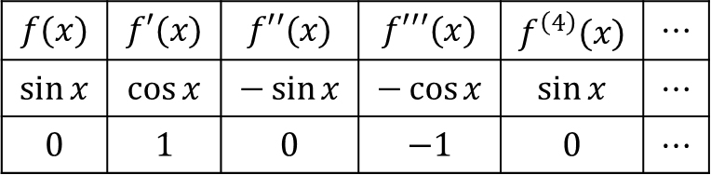

10.8 Taylor Series (11 of 37)
EXAMPLE: Expansions of Sine and Cosine We show that the following Maclaurin expansions are valid for all x:
$$\sin{x}=\sum_{n=0}^{∞}{{(−1)}^{n}\frac{x^{2n+1}}{\left(2n+1\right)!}}=x−\frac{x^{3}}{3!}±⋯$$
$$\cos{x}=\sum_{n=0}^{∞}{{(−1)}^{n}\frac{x^{2n}}{\left(2n\right)!}}=1−\frac{x^{2}}{2!}±⋯$$
The derivatives of f (x) = sin x and their values at x = 0 form a repeating pattern of period 4:
$$f(x)$$ | $$f′(x)$$ | $$f′′(x)$$ | $$f′′′(x)$$ | $$f^{\left(4\right)}(x)$$ | $$⋯$$
$$\sin{x}$$ | $$\cos{x}$$ | $$−\sin{x}$$ | $$−\cos{x}$$ | $$\sin{x}$$ | $$⋯$$
$$0$$ | $$1$$ | $$0$$ | $$−1$$ | $$0$$ | $$⋯$$

Slide 159

10.8 Taylor Series (12 of 37)
In other words, the even derivatives are zero and the odd derivatives alternate in sign:
f ^{(2n+1)}(0) = (−1)^{n} . Therefore, the nonzero Taylor coefficients for sin x are
$$a_{2n+1}={(−1)}^{n}\frac{1}{\left(2n+1\right)!}$$
For f (x) = cos x, the situation is reversed. The odd derivatives are zero and the even ones alternate in sign: f ^{(2n)}(0) = (−1)^{n} cos 0 = (−1)^{n} . Therefore, the nonzero Taylor coefficients for cos x are a_{2n} = (−1)^{n} /(2n)!.
We can apply the last theorem with K = 1 and any value of R because both sine and cosine satisfy | f ^{(n)}(x)|≤ 1 for all x and n. The conclusion is that the Taylor series converges to f (x) for |x| < R. Since R is arbitrary, the Taylor expansions hold for all x.

Slide 160

10.8 Taylor Series (13 of 37)
EXAMPLE: Taylor Expansion of f (x) = e^{x} at x= c Find the Taylor series T (x) of f (x) = e^{x} at x = c.
Solution We have f ^{(n)}(c) = e^{c} for all x. Thus,
$$T\left(x\right)=\sum_{n=0}^{∞}{\frac{e^{c}}{n!}{(x−c)}^{n}}$$
Because f (x) = e^{x} is increasing for all R > 0, | f ^{(k)}(x)|≤ e^{c+R} for x∈ (c − R, c + R). By the last theorem with K = e^{c+R} , we obtain that T (x) converges to f (x) for all x ∈ (c − R, c + R). Since R is arbitrary, the Taylor expansion holds for all x. For c = 0, we obtain the standard Maclaurin series
$$T\left(x\right)=\sum_{n=0}^{∞}{\frac{e^{c}}{n!}{(x−c)}^{n}}=1+x+\frac{x^{2}}{2!}+\frac{x^{3}}{3!}+⋯$$

Slide 161

10.8 Taylor Series (14 of 37)
There are several methods for generating new Taylor series from known ones. First of all, we can differentiate and integrate a Taylor series term by term within its interval of convergence, by Section 10.6. We can also multiply two Taylor series or substitute one Taylor series into another (we omit the proofs of these facts).
EXAMPLE:
$x^{2}e^{x}=x^{2} \left(1+x+\frac{x^{2}}{2!}+\frac{x^{3}}{3!}+⋯\right)=x^{2}+x^{3}+\frac{x^{4}}{2!}+\frac{x^{5}}{3!}+⋯=\sum_{n=2}^{∞}{\frac{x^{n}}{\left(n−2\right)!}}$
$e^{−x^{2}}=\sum_{n=0}^{∞}{\frac{{(−x^{2})}^{n}}{n!}}=\sum_{n=0}^{∞}{\frac{{(−1)}^{n}}{n!}x^{2n}}=1−x^{2}+\frac{x^{4}}{2!}−\frac{x^{6}}{3!}+⋯$
The Taylor expansion of e^{x} is valid for all x, so these expansions are also valid for all x.

Slide 162

10.8 Taylor Series (15 of 37)
EXAMPLE: Integration To find the Maclaurin series for f (x) = ln(1 + x), we integrate the geometric series with common ratio − x (valid for $|x|$ < 1):
$$\frac{1}{1+x}=\sum_{n=0}^{∞}{{(−1)}^{n}x^{n}}$$
$$\ln\left(1+x\right)=\int{\frac{1}{1+x}dx}=\int{\left(\sum_{n=0}^{∞}{{(−1)}^{n}x^{n}}\right)dx}$$
$$=A+\sum_{n=0}^{∞}{\frac{{(−1)}^{n}}{n+1}x^{n+1}}$$
The constant of integration A on the right is zero because ln(1 + x) = 0 for x= 0, so
$$\ln\left(1+x\right)=\sum_{n=1}^{∞}{\frac{{(−1)}^{n−1}}{n}x^{n}}$$
This expansion is valid for $\left|x\right|$ < 1. It also holds for x = 1 (see Exercise 92).

Slide 163
10.8 Taylor Series (16 of 37)
In many cases, there is no convenient formula for the coefficients of a Taylor series for a given function, but we can still compute as many coefficients as desired, as the next example demonstrates.
EXAMPLE: Multiplying Taylor Series Write out the terms up to degree 5 in the Maclaurin series for f (x) = e^{x} cos x.
Solution When we multiply the fifth-order Taylor polynomials of e^{x} and cos x together, distributing the term on the left and ignoring terms of degree greater than 5, we obtain

Slide 164

10.8 Taylor Series (17 of 37)
$$\left(1+x+\frac{x^{2}}{2}+\frac{x^{3}}{6}+\frac{x^{4}}{24}+\frac{x^{5}}{120}\right)\left(1−\frac{x^{2}}{2}+\frac{x^{4}}{24}\right)$$
$$=1+x+\frac{x^{2}}{2}+\frac{x^{3}}{6}+\frac{x^{4}}{24}+\frac{x^{5}}{120}−\left(1+x+\frac{x^{2}}{2}+\frac{x^{3}}{6}\right)\frac{x^{2}}{2}+(1+x)\frac{x^{4}}{24}$$
$$=1+x−\frac{x^{3}}{3}−\frac{x^{4}}{24}−\frac{x^{5}}{30}$$
$\text{We} \text{conclude} \text{that} \text{the} \text{Maclaurin} \text{series} \text{for} \text{f} \text{(}\text{x}\text{)} \text{=} \text{e}\text{x} \text{co}\text{s} \text{x} \text{(}\text{with} \text{the} \text{terms} \text{up} \text{to} \text{degree} \text{5) }\text{appear}\text{s} \text{a}\text{s}$:
$$e^{x}\cos{x}=1+x−\frac{x^{3}}{3}−\frac{x^{4}}{24}−\frac{x^{5}}{30}+⋯$$

Slide 165

10.8 Taylor Series (18 of 37)
EXAMPLE: a) We express $J=\int_{0}^{1}{\sin\left(x^{2}\right)dx}$ as an infinite series:
$$\sin\left(x^{2}\right)=\sum_{n=0}^{∞}{\frac{{(−1)}^{n}}{\left(2n+1\right)!}}{\left(x^{2}\right)}^{2n+1}=\sum_{n=0}^{∞}{\frac{{(−1)}^{n}}{\left(2n+1\right)!}}x^{4n+2}$$
$$J=\int_{0}^{1}{\sin\left(x^{2}\right)dx=}\sum_{n=0}^{∞}{\frac{{(−1)}^{n}}{\left(2n+1\right)!}}\int_{0}^{1}{x^{4n+2}dx}$$
$$=\sum_{n=0}^{∞}{\frac{{(−1)}^{n}}{\left(2n+1\right)!}}\frac{x^{4n+3}}{4n+3}|_{0}^{1}=\sum_{n=0}^{∞}{\frac{{(−1)}^{n}}{(4n+1)\left(2n+1\right)!}}$$

Slide 166

10.8 Taylor Series (19 of 37)
b) The infinite series for J is an alternating series with decreasing terms, so the sum of the first N terms is accurate to within an error that is less than the (N + 1)st term. The absolute value of the fourth term 1/75,600 is smaller than 10⁻⁴, so we obtain the desired accuracy using the first three terms of the series for J:
$$J≈\frac{1}{3}−\frac{1}{42}+\frac{1}{1340}≈\text{0.31028}$$
The error satisfies
$\left|J−\left(\frac{1}{3}−\frac{1}{42}+\frac{1}{1340}\right)\right|<\frac{1}{75,600}≈1.5∙{10}^{−5}$
less than 0.005% with just three terms.

Slide 167

10.8 Taylor Series (20 of 37)
The next example demonstrates how power series can be used to assist in the evaluation of limits.
EXAMPLE:
$$\lim_{x→0}{\frac{x−\sin{x}}{x^{3}\cos{x}}}=\lim_{x→0}{\frac{x−\left(x−\frac{x^{3}}{3!}+\frac{x^{5}}{5!}−⋯\right)}{x^{3}\left(1−\frac{x^{2}}{2!}+\frac{x^{4}}{4!}−⋯\right)}}=\lim_{x→0}{\frac{\frac{x^{3}}{3!}−\frac{x^{5}}{5!}+⋯}{x^{3}\left(1−\frac{x^{2}}{2!}+\frac{x^{4}}{4!}−⋯\right)}}$$
$$=\lim_{x→0}{\frac{\frac{1}{3!}−\frac{x^{2}}{5!}+⋯}{\left(1−\frac{x^{2}}{2!}+\frac{x^{4}}{4!}−⋯\right)}}=\frac{1}{3!}=\frac{1}{6}$$

Slide 168

10.8 Taylor Series (21 of 37)
Isaac Newton discovered an important generalization of the Binomial Theorem around 1665. For any number a (integer or not) and integer n ≥ 0, we define the binomial coefficient:
$$\left({a \atop n}\right)=\frac{a(a−1)⋯(a−n+1)}{n!}, \left({a \atop 0}\right)=1$$
For instance,
$$\left({6 \atop 3}\right)=\frac{6∙5∙4}{3∙2∙1}=20,\left({4/3 \atop 3}\right)=\frac{\left(4/3\right)\left(1/3\right)\left(−2/3\right)}{3∙2∙1}=−\frac{4}{81}$$
The Binomial Theorem of algebra (see Appendix C) states that for any whole number a,
$${(r+s)}^{a}=r^{a}+\left({a \atop 1}\right)r^{a−1}s+\left({a \atop 2}\right)r^{a−2}s^{2}+⋯+\left({a \atop a−1}\right)rs^{a−1}+s^{a}$$

Slide 169

10.8 Taylor Series (22 of 37)
Let $f (x) = (1 + x)a$, and set r = 1 and s = x in the Binomial Theorem. We get the expansion
$$f \left(x\right)= \left(1 + x\right)a=1+\left({a \atop 1}\right)x+\left({a \atop 2}\right)x^{2}+⋯+\left({a \atop a−1}\right)x^{a−1}+x^{a}$$
We derive Newton’s generalization by computing the Maclaurin series of f (x) without assuming that a is a whole number. Observe that the derivatives follow a pattern:

Slide 170

10.8 Taylor Series (23 of 37)
$$f\left(x\right)={(1+x)}^{a}, f\left(0\right)=1$$
$$f^{′}\left(x\right)=a{(1+x)}^{a−1}, f^{′}\left(0\right)=a$$
$$f^{′′}\left(x\right)=a(a−1){\left(1+x\right)}^{a−2}, f^{′′}\left(0\right)=a(a−1)$$
$$f^{′′′}\left(x\right)=a(a−1){\left(a−2\right)\left(1+x\right)}^{a−3}, f^{′′}\left(0\right)=a(a−1)(a−2)$$
In general, f ^{(n)}(0) = a(a − 1)(a − 2) ··· (a − n + 1) and
$$\frac{f^{\left(n\right)}(0)}{n!}=\frac{\text{a}\text{(}\text{a} \text{−} \text{1)}\text{(}\text{a} \text{−} \text{2}\text{)} \text{··}\text{·} \text{(}\text{a} \text{−} \text{n} \text{+} \text{1}\text{)}}{n!}=\left({a \atop n}\right)$$
Hence, the Maclaurin series for f (x) = (1 + x)ª is the binomial series
$$\sum_{n=1}^{∞}{\left({a \atop n}\right)x^{n}}=1+ax+\frac{a(a−1)}{2!}x^{2}+\frac{a(a−1)(a−2)}{3!}x^{3}+⋯+\left({a \atop n}\right)x^{n}+⋯$$

Slide 171

10.8 Taylor Series (24 of 37)
The Ratio Test shows that this series has radius of convergence R = 1 (Exercise 94), and an additional argument (developed in Exercise 95) shows that it converges to (1 + x)ª for |x| < 1 .
THEOREM: The Binomial Series
For any exponent a and for |x| < 1,
$${(1+x)}^{a}=1+ax+\frac{a(a−1)}{2!}x^{2}+\frac{a(a−1)(a−2)}{3!}x^{3}+⋯+\left({a \atop n}\right)x^{n}+⋯$$

Slide 172

10.8 Taylor Series (25 of 37)
EXAMPLE: We find the terms through degree 4 in the Maclaurin expansion of
$f(x) = {(1+x)}^{4/3}$.
The binomial coefficients $\left({4/3 \atop n}\right)$ for 0 ≤ n ≤ 4 are
$$1, \frac{\frac{4}{3}}{1!}=\frac{4}{3}, \frac{\frac{4}{3}∙\frac{1}{3}}{2!}=\frac{2}{9}, \frac{\frac{4}{3}∙\frac{1}{3}∙\left(−\frac{2}{3}\right)}{3!}=−\frac{4}{81},\frac{\frac{4}{3}∙\frac{1}{3}∙\left(−\frac{2}{3}\right)∙\left(−\frac{5}{3}\right)}{4!}=\frac{5}{243}.$$
Therefore,
$${(1+x)}^{4/3} =1+\frac{4}{3}x+\frac{2}{9}x^{2}−\frac{4}{81}x^{3}+\frac{5}{243}x^{5}+⋯$$

Slide 173

10.8 Taylor Series (26 of 37)
EXAMPLE: We find the Maclaurin series for $f\left(x\right)=\frac{1}{\sqrt{1 − x^{2}}}.$ First, let’s find the coefficients in the binomial series for (1 + u)^{−1/2}:
$$1, \frac{−\frac{1}{2}}{1!}=−\frac{1}{2}, \frac{\left(−\frac{1}{2}\right)\left(−\frac{3}{2}\right)}{2!}=\frac{1∙3}{2∙4}, \frac{\left(−\frac{1}{2}\right)\left(−\frac{3}{2}\right)\left(−\frac{5}{2}\right)}{3!}=−\frac{1∙3∙5}{2∙4∙6}$$
The general pattern is
$$\left({−1/2 \atop n}\right)=\frac{\left(−\frac{1}{2}\right)\left(−\frac{3}{2}\right)\left(−\frac{5}{2}\right)⋯\left(−\frac{2n−1}{2}\right)}{n!}={(−1)}^{n}\frac{1∙3∙5∙⋯∙(2n−1)}{2∙4∙6∙⋯∙2n}$$

Slide 174

10.8 Taylor Series (27 of 37)
Thus, the following binomial expansion is valid for |x| < 1:
$$\frac{1}{\sqrt{1+u}}=1+\sum_{n=1}^{∞}{{(−1)}^{n}\frac{1∙3∙5∙⋯∙(2n−1)}{2∙4∙6∙⋯∙2n}u^{n}}=1+\frac{1}{2}u+\frac{1∙3}{2∙4}u^{2}+⋯$$
If |x| < 1, then |x|² < 1, and we can substitute u = −x² for x to obtain
$$\frac{1}{\sqrt{1−x^{2}}}=1+\sum_{n=1}^{∞}{\frac{1∙3∙5∙⋯∙(2n−1)}{2∙4∙6∙⋯∙2n}x^{2n}}=1+\frac{1}{2}x^{2}+\frac{1∙3}{2∙4}x^{4}+⋯$$

Slide 175

10.8 Taylor Series (28 of 37)
Taylor series are particularly useful for studying the so-called special functions (such as Bessel and hypergeometric functions) that appear in a wide range of physics and engineering applications.
One example is the following elliptic integral of the first kind, which is defined for |k| < 1:
$$E\left(k\right)=\int_{0}^{π/2}{\frac{dt}{\sqrt{1−k^{2}\sin^{2}{t}}}}$$

Slide 176
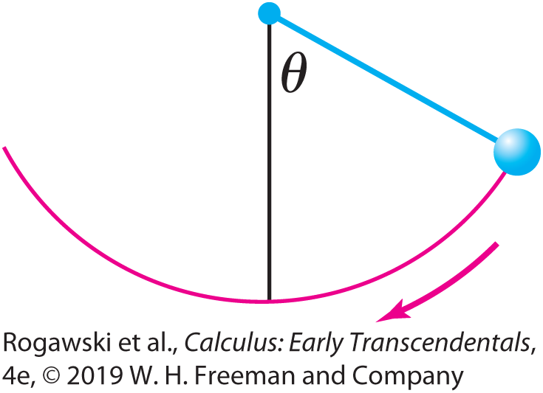

10.8 Taylor Series (29 of 37)
This function is used in physics to compute the period T of pendulum of length L released from an angle θ. We can use the small-angle approximation $T≈2π\sqrt{\frac{L}{g}}$ when θ is small (where g = 9.8 m/s²), but this approximation breaks down for large angles (Figure 2). The exact value of the period is $T≈4\sqrt{\frac{L}{g}}E(k)$, where $k=\sin\left(\frac{1}{2}θ\right)$.

Slide 177

10.8 Taylor Series (30 of 37)
EXAMPLE: Elliptic Function We find the Maclaurin series for E(k) and estimate E(k) for $k=\sin{\frac{π}{6}}.$ Substitute x = k sin t in the Taylor expansion
$$\frac{1}{\sqrt{1−k^{2}\sin^{2}{t}}}=1+\sum_{n=1}^{∞}{\frac{1∙3∙5∙⋯∙(2n−1)}{2∙4∙6∙⋯∙2n}{(k\sin{t)}}^{2n}}$$
This expansion is valid because |k| < 1 and hence, |x|= |k sin t | < 1.

Slide 178

10.8 Taylor Series (31 of 37)
Thus, E (k) is equal to
$$\int_{0}^{π/2}{\frac{dt}{\sqrt{1−k^{2}\sin^{2}{t}}}}=\int_{0}^{π/2}{dt}+\sum_{n=1}^{∞}{\frac{1∙3∙5∙⋯∙(2n−1)}{2∙4∙6∙⋯∙2n}k^{2n}\int_{0}^{π/2}{\sin^{2n} tdt}}$$
According to Exercise 76 in Section 7.2,
$$\int_{0}^{π/2}{\sin^{2n} tdt}=\frac{1∙3∙5∙⋯∙(2n−1)}{2∙4∙6∙⋯∙2n}∙\frac{π}{2}$$

Slide 179

10.8 Taylor Series (32 of 37)
This yields
$$E\left(k\right)=\frac{π}{2}+\frac{π}{2}\sum_{n=1}^{∞}{{\left(\frac{1∙3∙5∙⋯∙(2n−1)}{2∙4∙6∙⋯∙2n}\right)}^{2}k^{2n}}$$
We approximate E (k) for $k=\sin{\frac{π}{6}=\frac{1}{2}}$ using the first five terms:
$$E\left(\frac{1}{2}\right)=\frac{π}{2}\left(1+{\left(\frac{1}{2}\right)}^{2}{\left(\frac{1}{2}\right)}^{2}+⋯+{\left(\frac{1∙3∙5∙7}{2∙4∙6∙8}\right)}^{2}{\left(\frac{1}{2}\right)}^{8}\right)≈\text{≈} \text{1.68517}$$

Slide 180

10.8 Taylor Series (33 of 37)
Euler’s formula expresses a surprising relationship between the exponential function, f (x) = e^{x}, and the basic trigonometric functions, g(x) = sin x and h(x) = cos x. This formula holds for all complex numbers. The complex numbers are numbers in the form a + bi, where a and b are real numbers and i is defined to be the square root of −1, that is, i ² = −1. We can add and multiply complex numbers:
(a + bi ) + (c + di ) = (a + c) + (b + d)i
(a + bi )(c + di ) = ac + adi + bci + bdi ² = (ac − bd) + (ad + bc)I
As a result, we can compute polynomial functions of a complex variable z = a + bi:
f (z) = a₀ + a₁ z + a₂ z² + ... + a_{n} z^{n}
We can measure the distance d between complex numbers:
$$d\left(a+bi,c+di\right)=\sqrt{{(c−a)}^{2} + {(d−b)}^{2}}$$

Slide 181

10.8 Taylor Series (34 of 37)
With such a measure of distance, we can address the convergence of a sequence or a series of complex numbers to a limit that is a complex number, just as we do with real numbers. In particular, the power series associated with e^{x}, sin x, and cos x can each be shown to converge for all complex numbers (the proofs are essentially the same as the proofs for the real-number case). In the field of complex variables, these series are often used to define the corresponding functions for all complex numbers z:
$$e^{z}=\sum_{n=0}^{∞}{\frac{z^{n}}{n!}}$$
$$\sin{z=\sum_{n=0}^{∞}{\frac{{(−1)}^{n}}{\left(2n+1\right)!}z^{2n+1}}},\cos{z=\sum_{n=0}^{∞}{\frac{{(−1)}^{n}}{\left(2n\right)!}z^{2n}}}$$

Slide 182
10.8 Taylor Series (35 of 37)
We can combine these series to obtain Euler’s formula.
THEOREM: Euler’s Formula For all complex numbers z,
e^{iz} = cos z + i sin z
Proof The key to the proof lies in the pattern of the powers of i. First, note that
i ⁰ = 1, i ¹ = i , i ² = −1, i ³ = i ²i = (−1)i = −i

Slide 183

10.8 Taylor Series (36 of 37)
Furthermore, i ⁴ = i ²i ² = (−1)(−1) = 1 and i ⁵ = i ⁴i = (1)i = i, and the cycle of values 1, i , −1, −i is now repeating. Therefore, starting with n = 0, the values of i^{n} repeatedly cycle through 1, i , −1, −i. We obtain
$$e^{iz}=\sum_{n=0}^{∞}{\frac{{(iz)}^{n}}{n!}}=1+iz−\frac{z^{2}}{2!}−i\frac{z^{3}}{3!}+\frac{z^{4}}{4!}+i\frac{z^{5}}{5!}−⋯$$
$$=\left(1−\frac{z^{2}}{2!}+\frac{z^{4}}{4!}−⋯\right)+i\left(z−\frac{z^{3}}{3!}+\frac{z^{5}}{5!}−⋯\right)$$
$$=\cos{z}+i\sin{z}$$

Slide 184

10.8 Taylor Series (37 of 37)
Euler’s formula is particularly useful in electrical engineering. Periodic signals are often expressed in terms of sine and cosine functions. Mathematical operations and computations involving combinations of signals are often more conveniently approached with the signals expressed in terms of complex exponential functions such as f (z) = e^{iz} .
If we substitute z = π into Euler’s formula, we obtain
e^{i π} = cos π + i sin π = −1 + i (0) = −1
Rearranging, this relation is expressed as $e^{iπ}+1=0.$ This equation is known as Euler’s Identity and is particularly pleasing because it relates five of the more important numbers used in mathematics and its applications.

